Slide 1
Meta-Analysis Basics
Brenton Wiernik

Slide 2
Evidence synthesis & systematic reviews
Systematic review: Research synthesis as a scientific process
Emphasis on transparent, replicable, and systematic methods to “limit bias in the assembly, critical appraisal, and synthesis of all relevant studies on a specific topic” (Last, 2001)
Transparency and clarity is key
Synthesis can use qualitative and/or quantitative methods
For some history, see Chalmers et al. (2002, https://doi.org/bvwspb)

Slide 3
What is meta-analysis?
Quantitative combination of statistical information from multiple empirical studies to produce an overall estimate of a particular relationship
Approach: Quantify the size, direction, and precision of the effect or association in each study and use this as primary data in further analyses

Slide 4
Questions Meta-Analysis Can Address
Meta-analysis examines whether an effect varies and, if so, how and why
What is the overall (average) size and direction of the effect or association?
How much do effects or associations vary across studies?
Does the effect or association depend on characteristics of the studies?

Slide 5
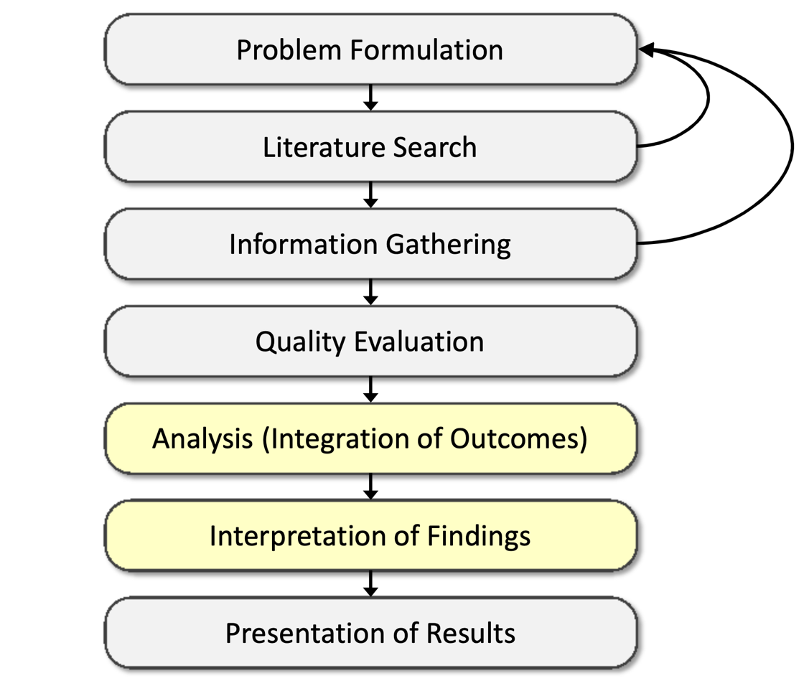
Meta-analysis in the SR process
Cooper (2016)
ISBN: 9781483331157

Slide 6
Logic of Meta-Analysis
Traditional narrative reviews are biased
Cannot be comprehensive
Often reflects reviewer bias
Typical focus on statistical significance testing
Significance testing misleads scientific inquiry
Highly dependent on sample size
Highly dependent on size of population effect
Null findings not given the same “weight” as significant findings
Meta-analysis changes the focus to the direction and magnitude of the effects across studies
Direction and magnitude represented by the effect size

Slide 7
Meta-analytic reviews
Meta-analysis is most frequently applied when conducting a review of a research literature
As an alternative to narrative reviews
A meta-analytic review is only useful if the review is carefully conducted and comprehensive
Medical meta-analyses are highly concerned with the quality of the review
Many psychology meta-analyses are rather sloppy with their review methods
This has been improving in recent years

Slide 8
When Can You Do Meta-analysis?
Meta-analysis is applicable to research studies that
Are empirical
Produce quantitative results
Examine the same constructs/variables and relationships
Have findings that can be expressed in a comparable statistical form (i.e., effect sizes: mean differences, correlation coefficients, odds-ratios, proportions, etc.)
Are substantively “comparable” given the question at hand

Slide 9
When Can You Do Meta-analysis?
How many studies do you need to do a meta-analysis?
Two
Continuously cumulating meta-analysis (Braver et al., 2014, https://doi.org/10/5k2)
Meta-analyses of different sizes let you draw different kinds of conclusions
Preliminary findings
Robust estimates
Moderator effects

Slide 10
Meta-Analysis Models

Slide 11
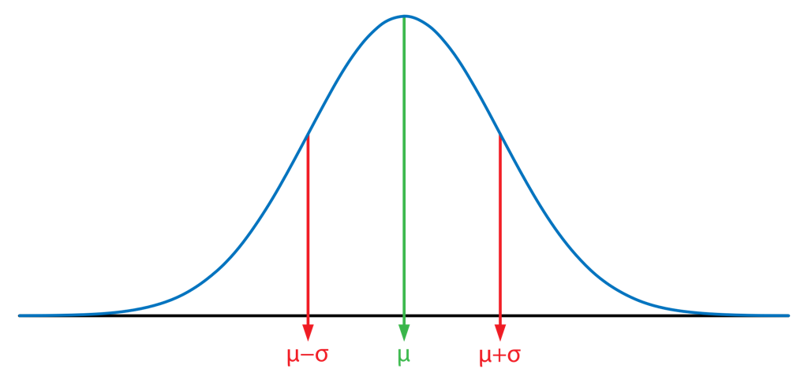
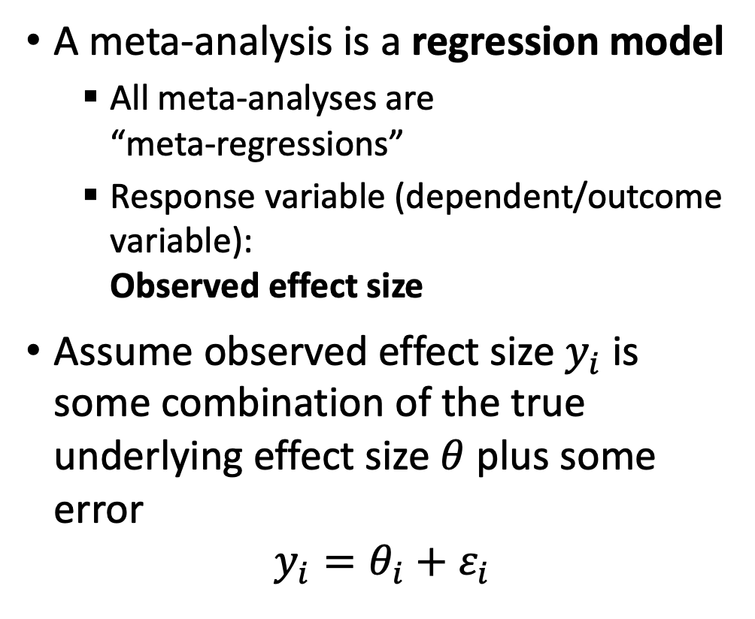
Basic Meta-Analysis Model
A meta-analysis is a regression model
All meta-analyses are “meta-regressions”
Response variable (dependent/outcome variable): Observed effect size
Assume observed effect size $y_{i}$ is some combination of the true underlying effect size $θ$ plus some error
$$y_{i}=θ_{i}+ε_{i}$$

Slide 12
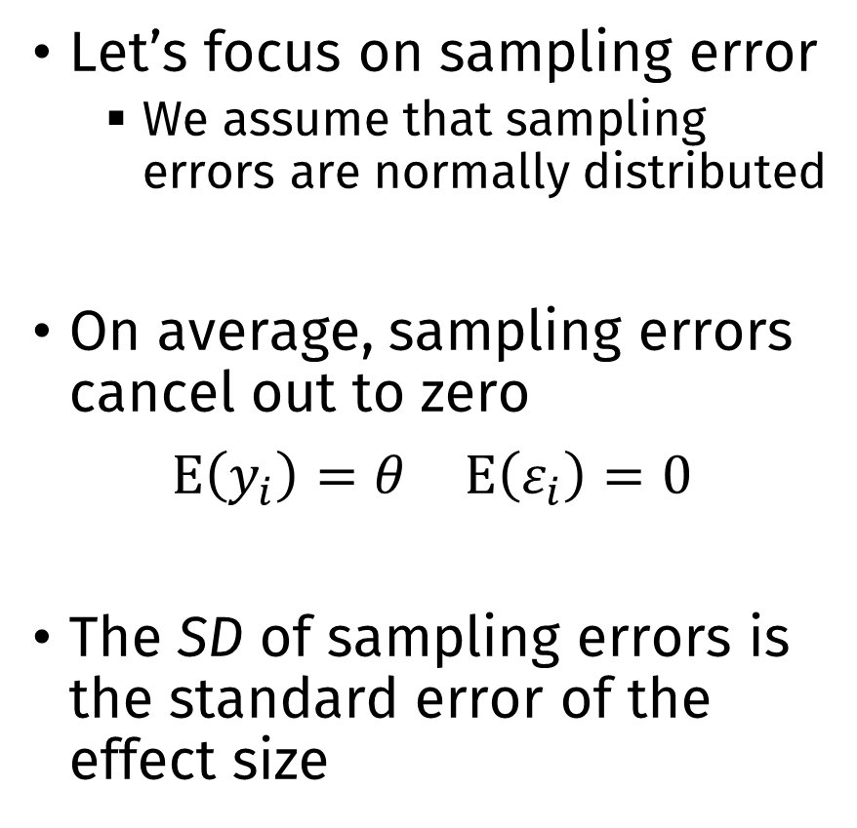
Basic Meta-Analysis Model
Let’s focus on sampling error
We assume that sampling errors are normally distributed
On average, sampling errors cancel out to zero
$E\left(y_{i}\right)=θ$ $E\left(ε_{i}\right)=0$
The SD of sampling errors is the standard error of the effect size

Slide 13
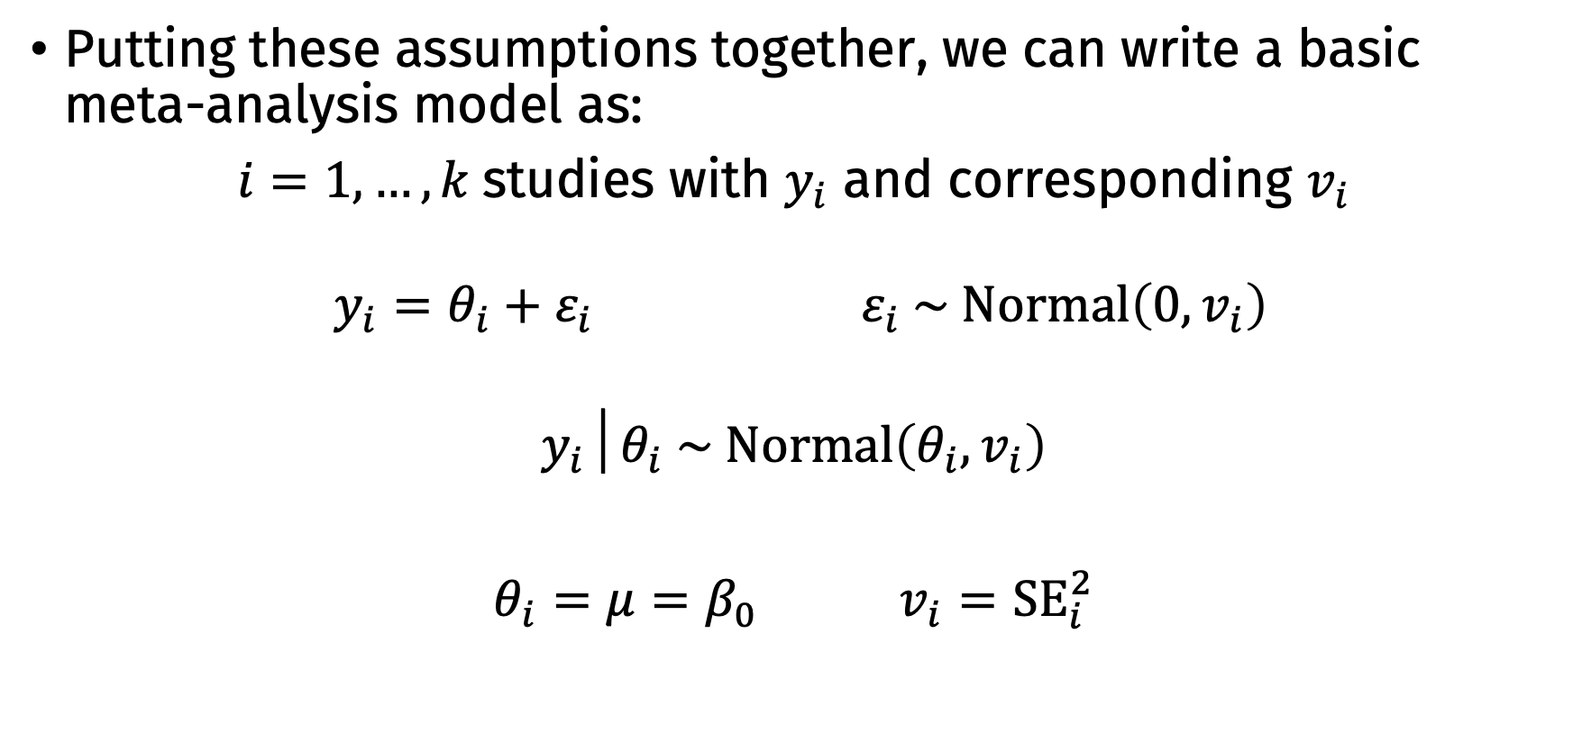
Basic Meta-Analysis Model
Putting these assumptions together, we can write a basic meta-analysis model as:
$i=1, …, k$studies with $y_{i}$ and corresponding $v_{i}$
$y_{i}=θ_{i}+ε_{i}$ $ε_{i} \sim Normal\left(0,v_{i}\right)$
$$y_{i}│θ_{i} \sim Normal\left(θ_{i},v_{i}\right)$$
$θ_{i}=μ=β_{0}$ $v_{i}={SE}_{i}^{2}$

Slide 14
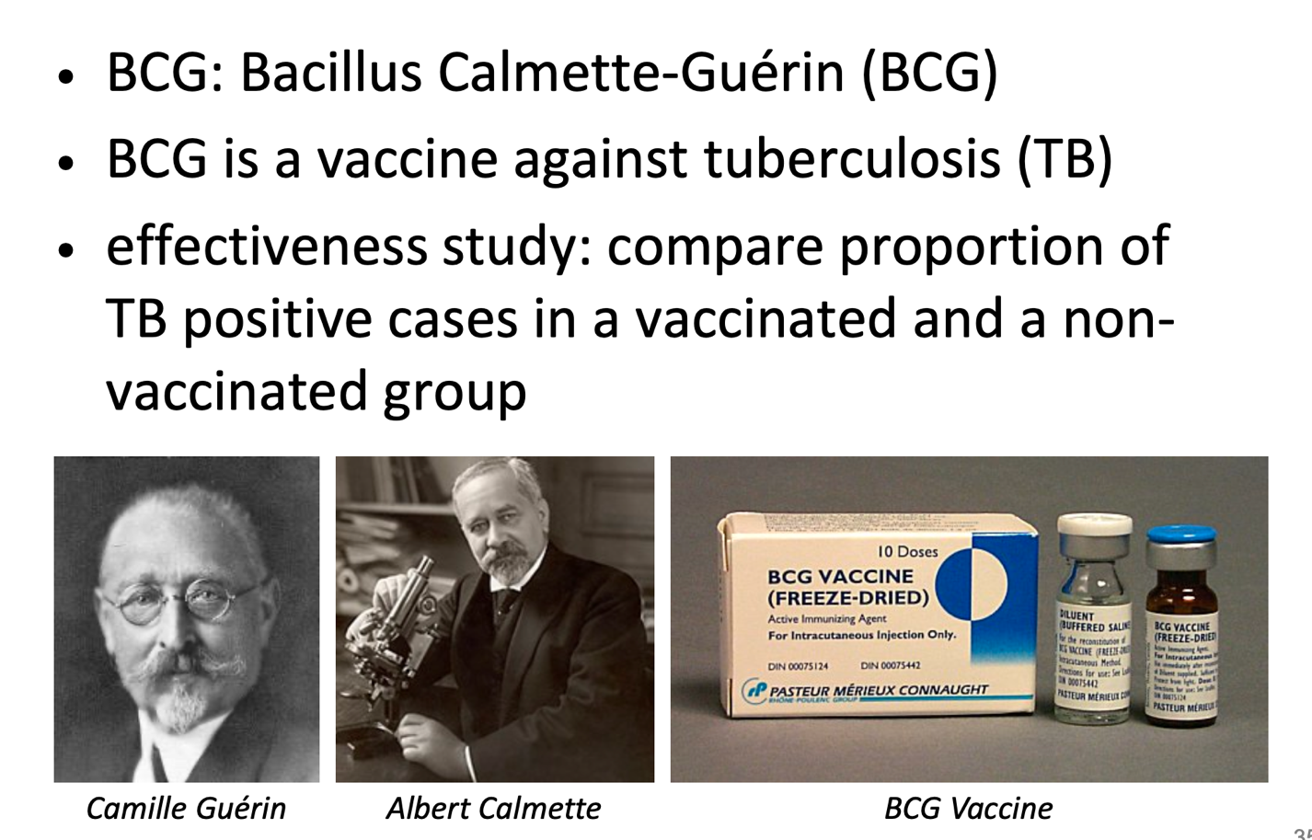
Example: BCG Vaccine

Slide 15
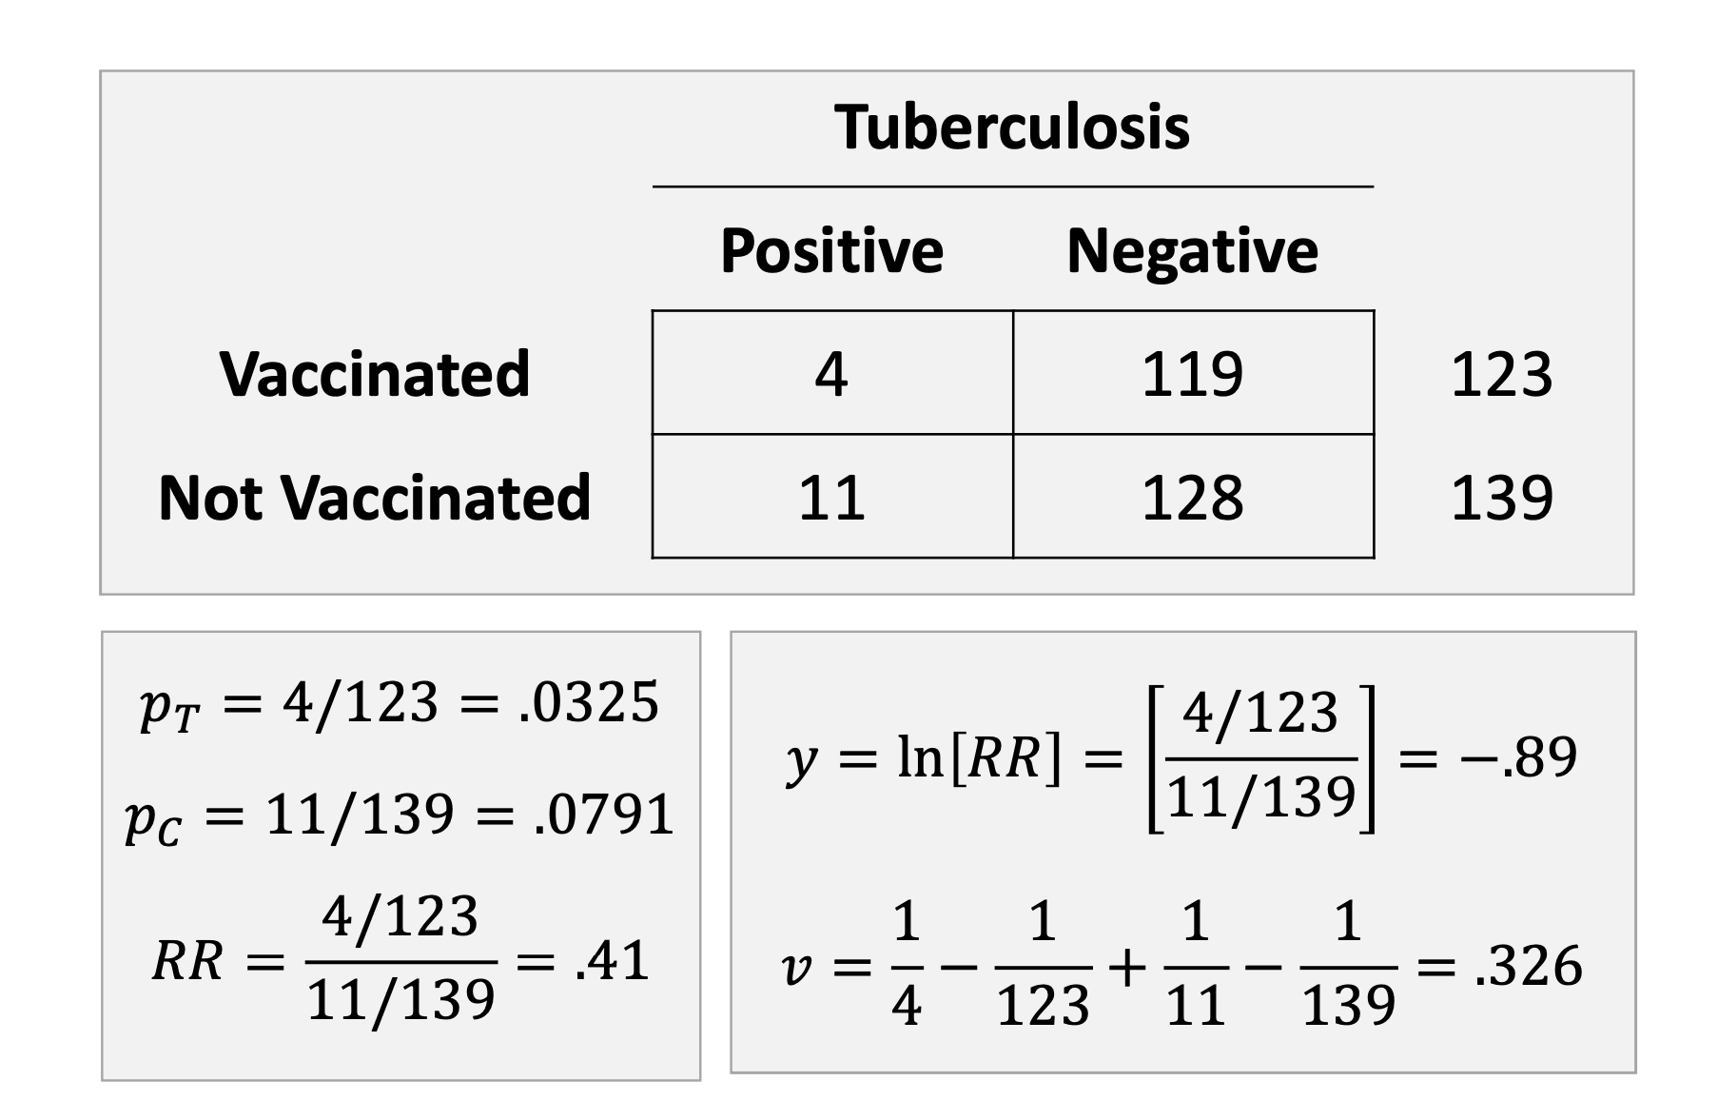

Slide 16
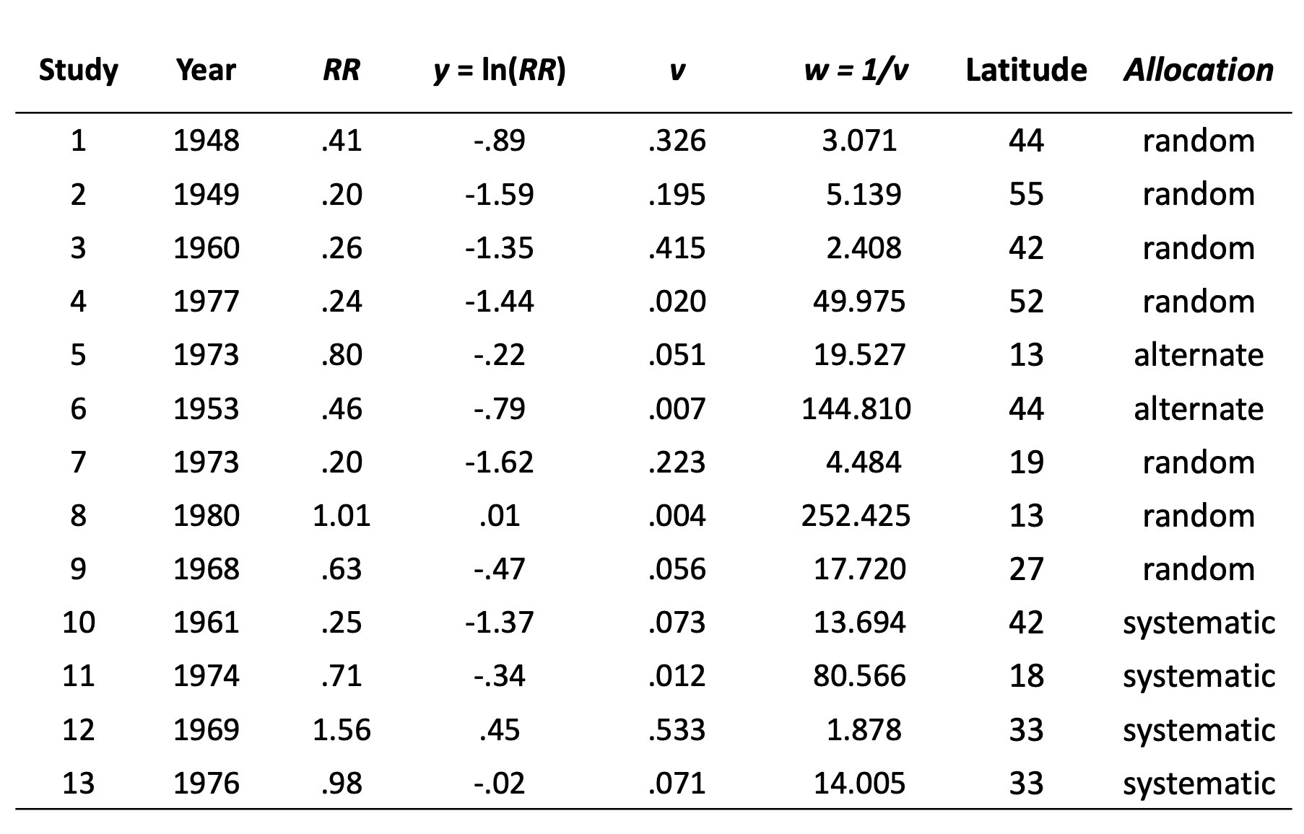
Example: BCG Vaccine

Slide 17
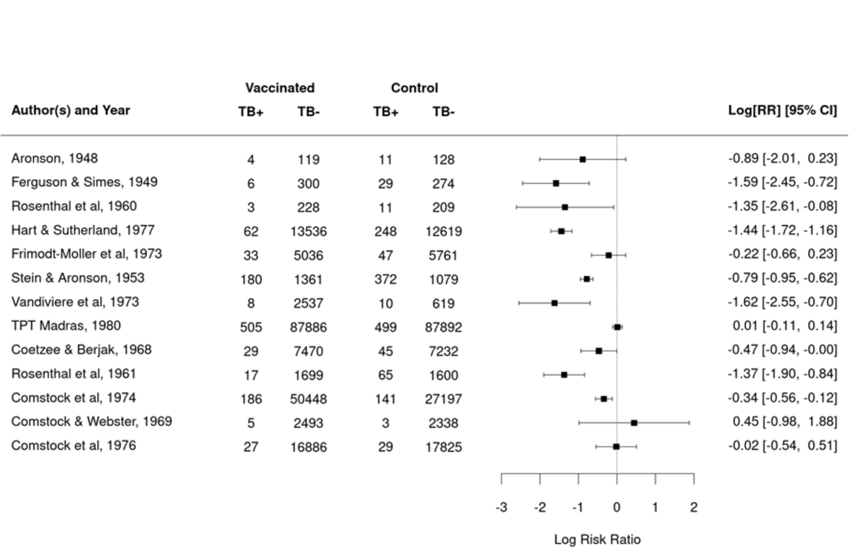
Example: BCG Vaccine Forest Plot

Slide 18
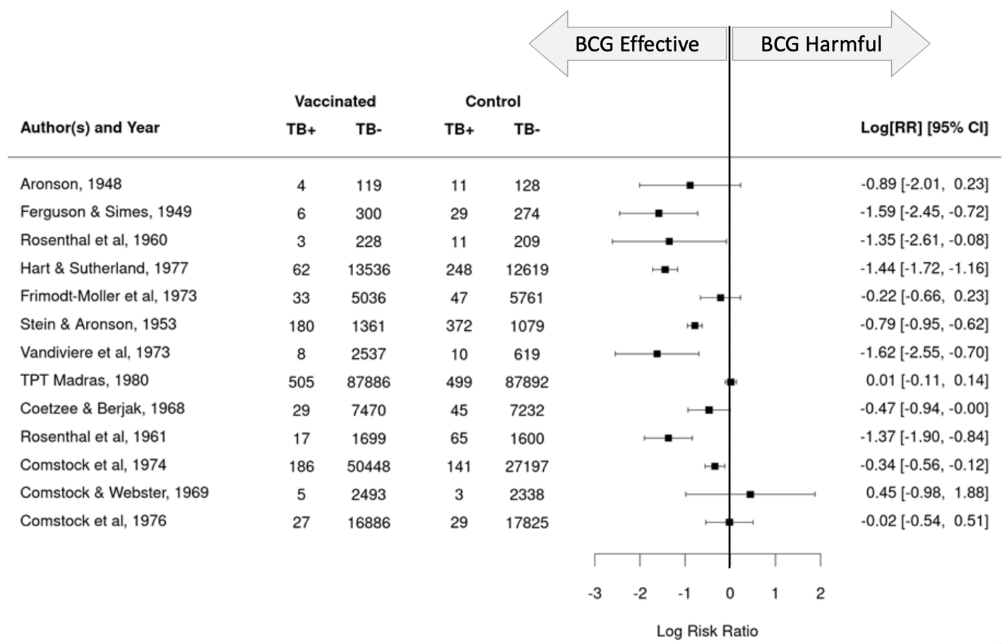
Example: BCG Vaccine Forest Plot

Slide 19
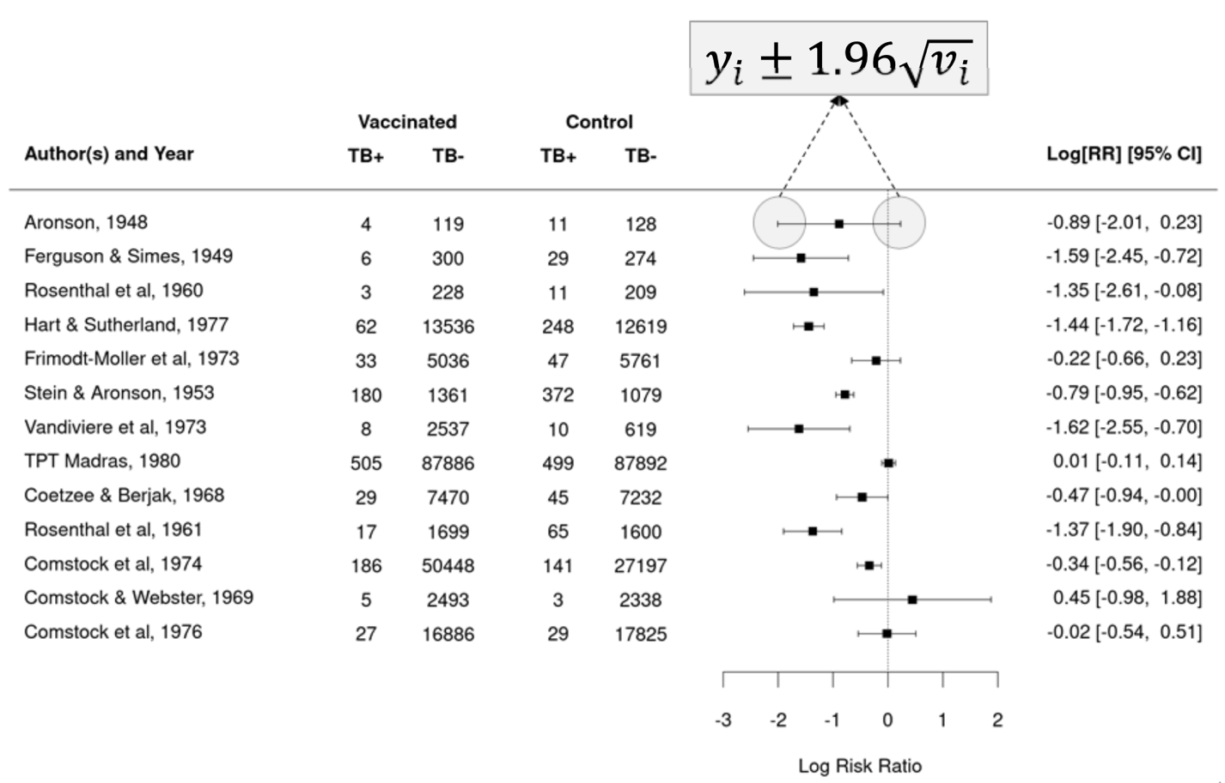
Example: BCG Vaccine Forest Plot

Slide 20
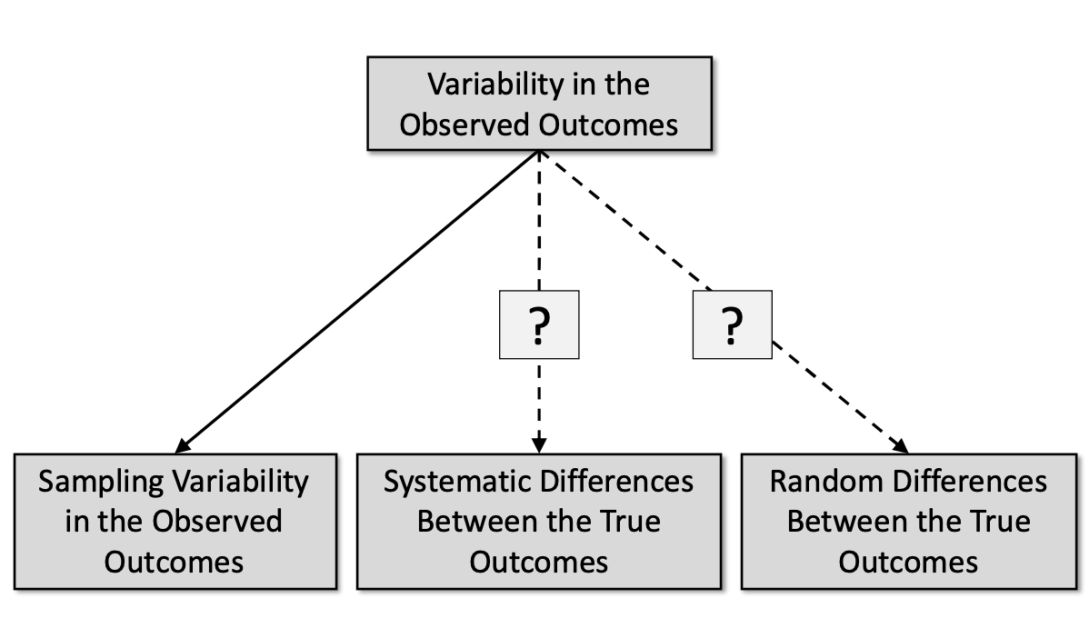
Why do these study outcomes differ?

Slide 21
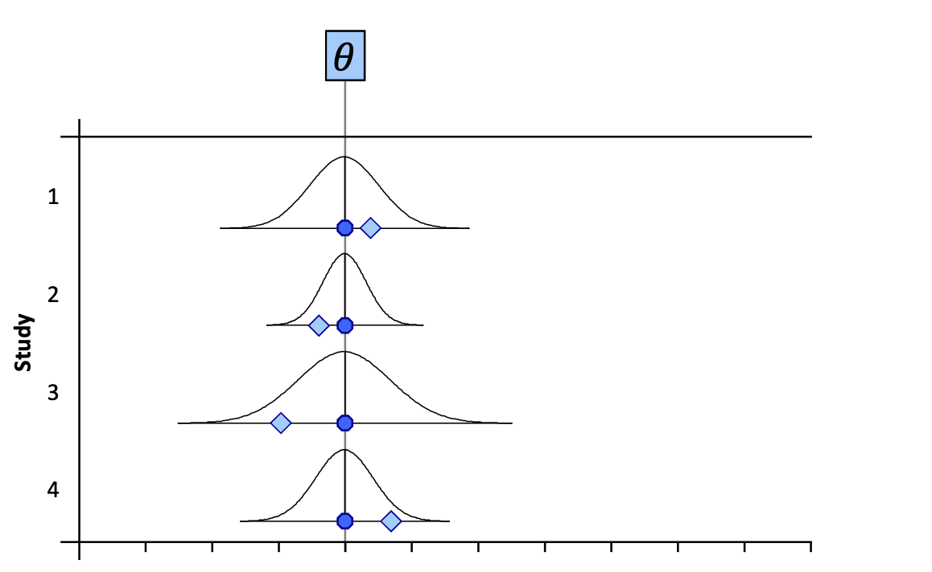
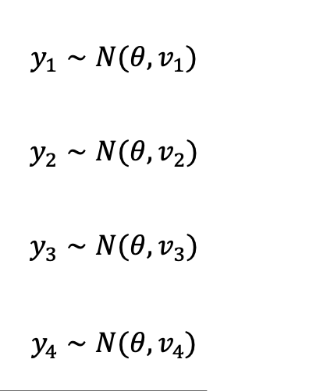
Equal Effects Model

Slide 22
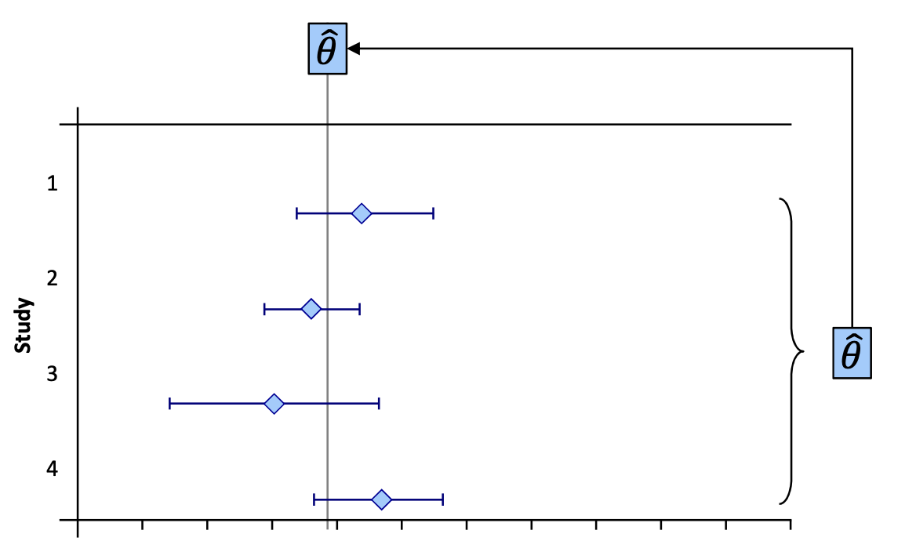
Equal Effects Model

Slide 23
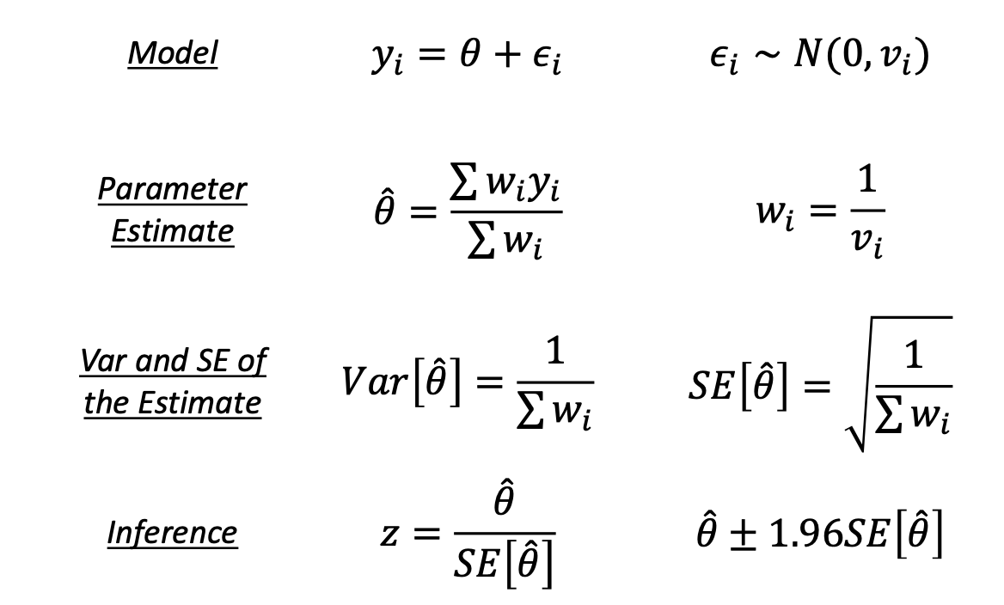
Equal Effects Model

Slide 24
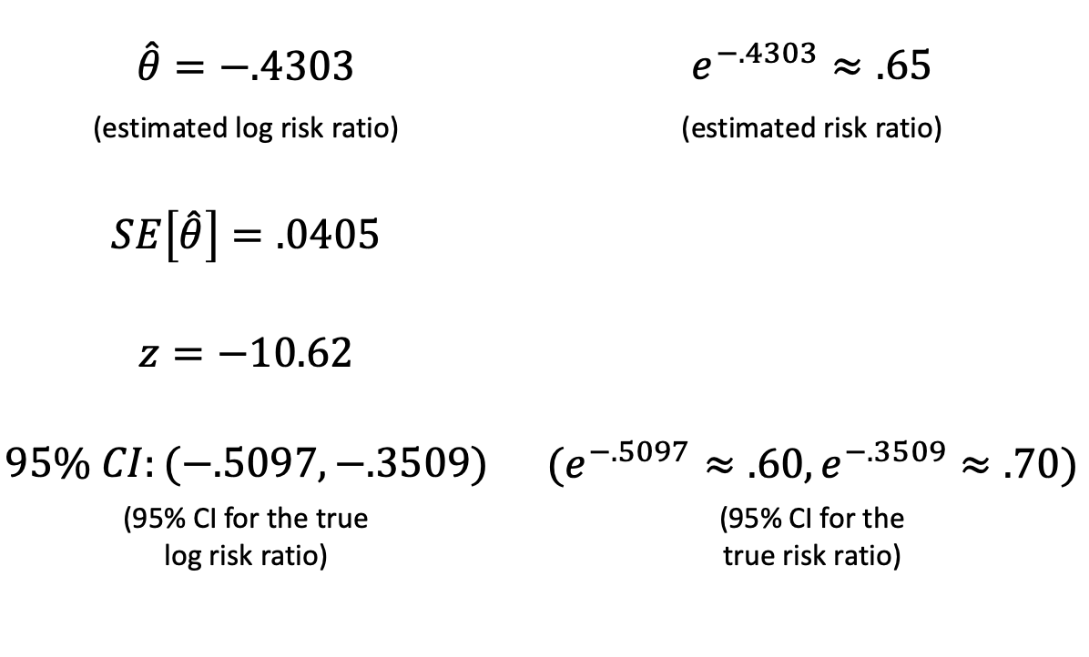
Equal Effects Model

Slide 25
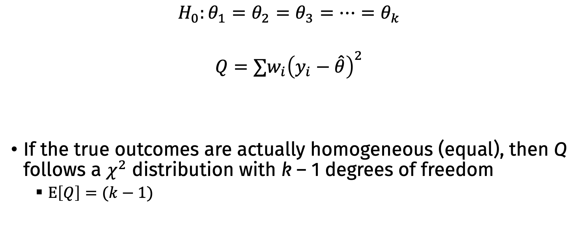
Testing for Heterogeneity
$$H_{0}:θ_{1}=θ_{2}=θ_{3}=…=θ_{k}$$
$$Q=∑w_{i}{\left(y_{i}−\hat{θ}\right)}^{2}$$
If the true outcomes are actually homogeneous (equal), then Q follows a $χ^{2}$ distribution with k – 1 degrees of freedom
$E\left[Q\right]=(k−1)$

Slide 26
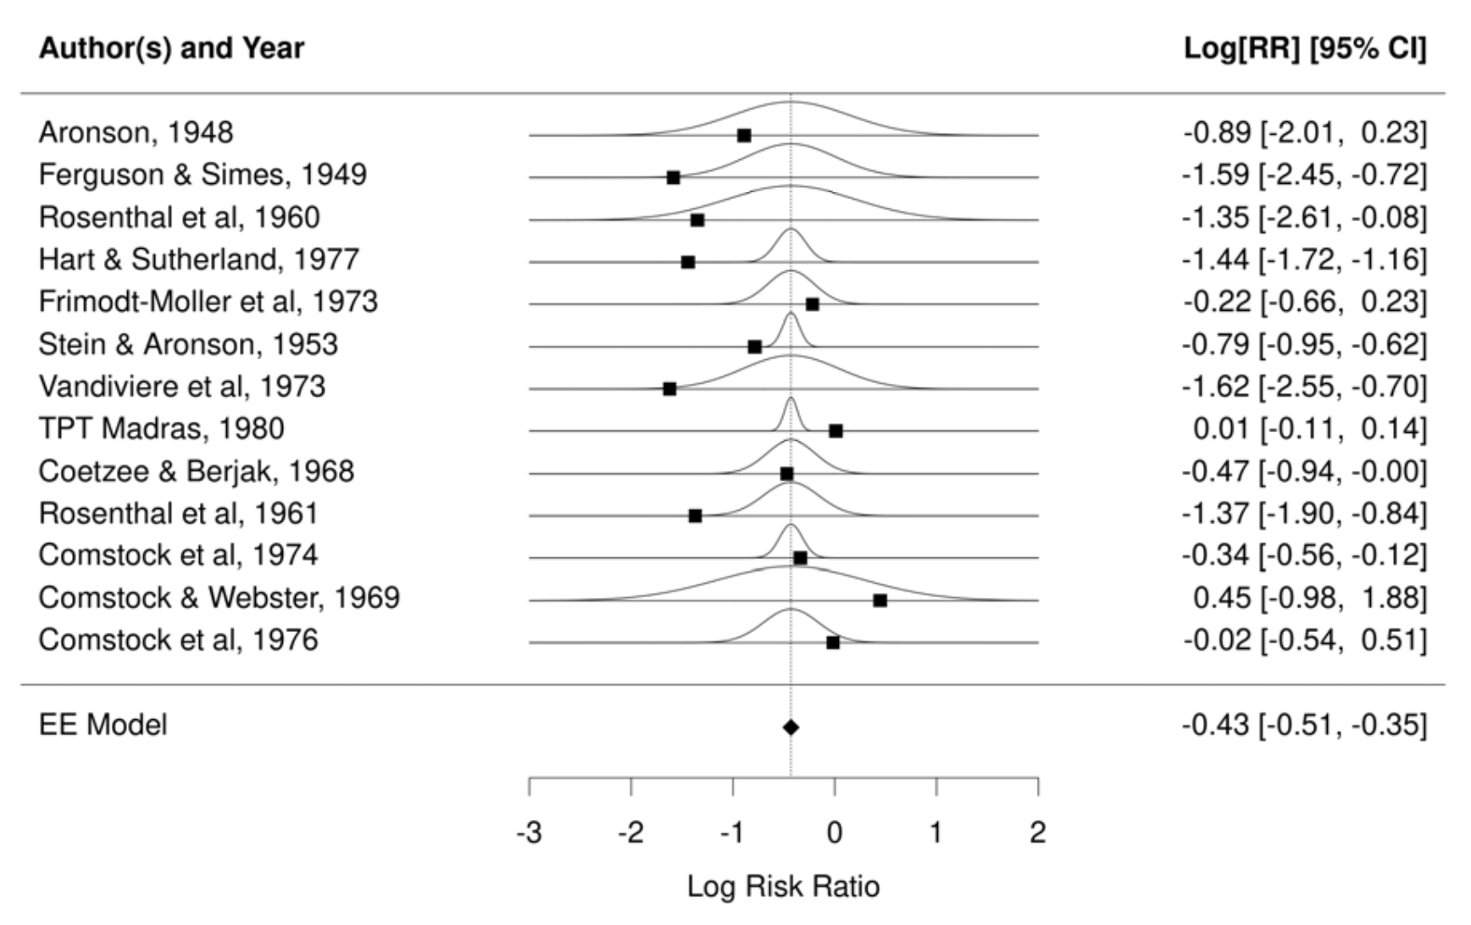

Slide 27
Example: BCG Vaccine
Q = 152.23
df = 12
For df = 12, α = .05 at 21.03
p < .0001
Is the equal effects model a good fit for these data?

Slide 28
Note: Do not use the Q test to choose a model
In general, I don’t think the Q test itself is useful
We should basically always assume that true outcomes are heterogeneous and model appropriately

Slide 29
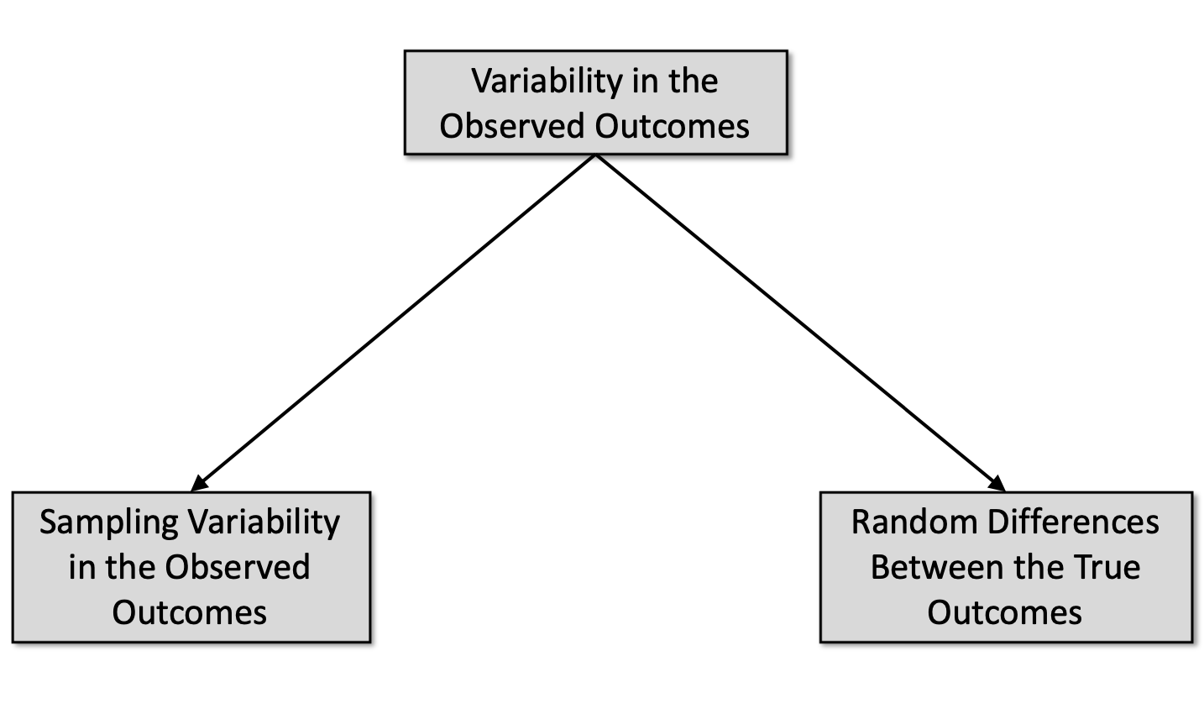
Why do these study outcomes differ?

Slide 30
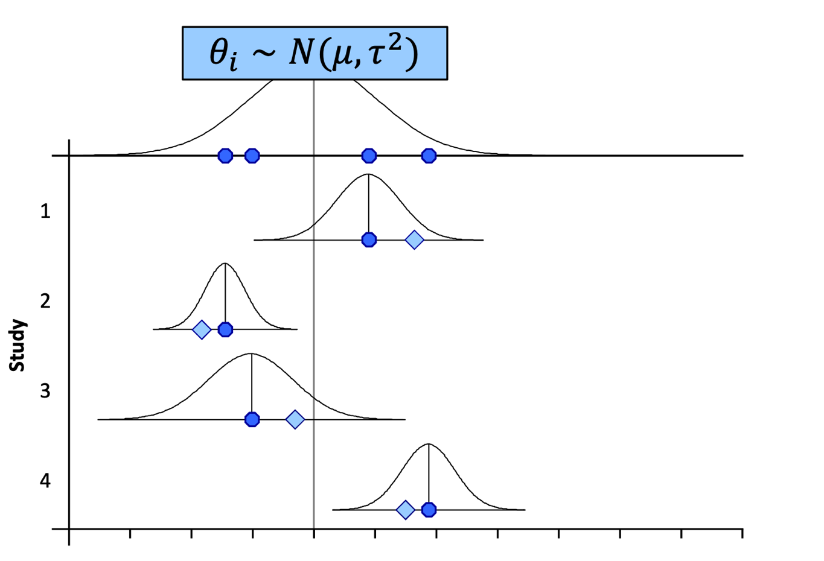
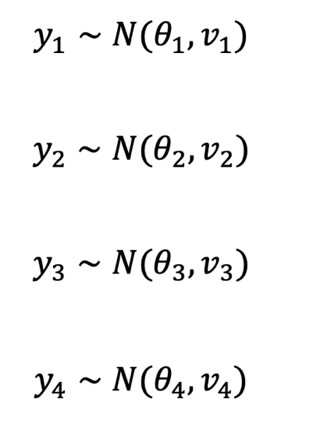
Random effects model

Slide 31
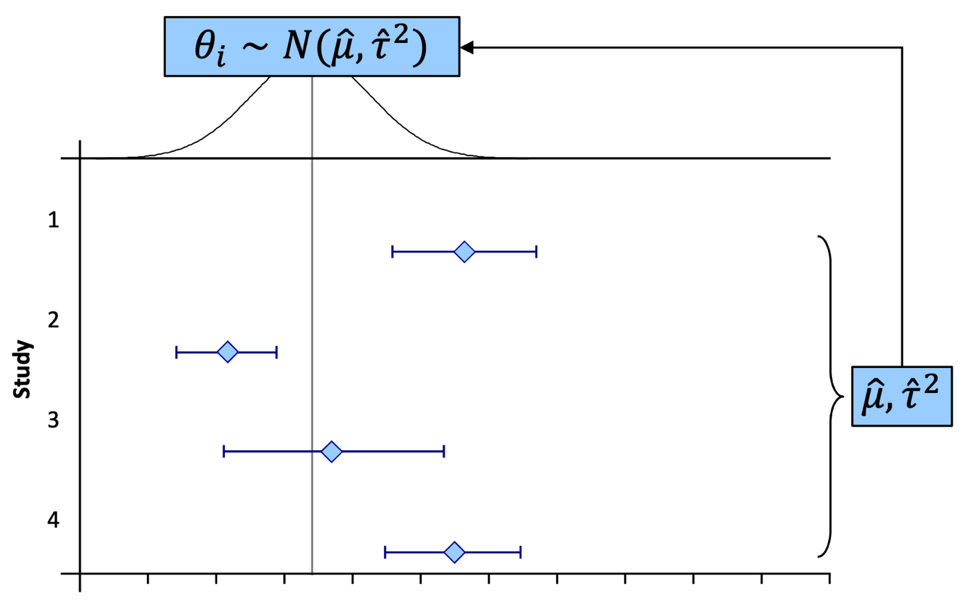
Random effects model

Slide 32
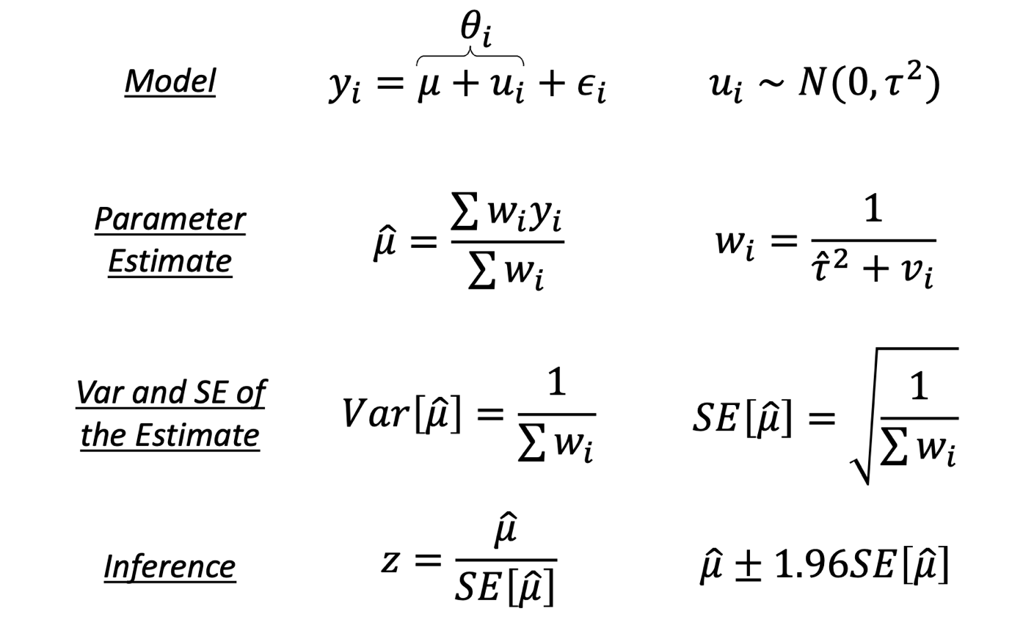
Random effects model

Slide 33
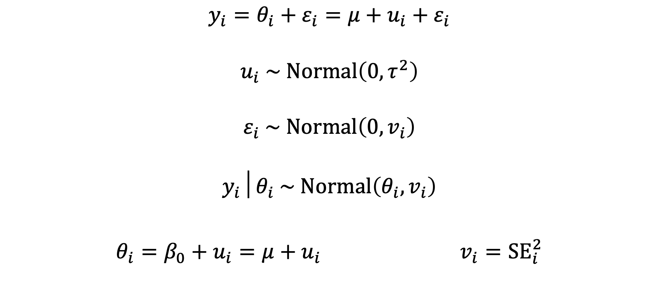
Random effects model
$$y_{i}=θ_{i}+ε_{i}=μ+u_{i}+ε_{i}$$
$$u_{i} \sim Normal\left(0,τ^{2}\right)$$
$$ε_{i} \sim Normal\left(0,v_{i}\right)$$
$$y_{i}│θ_{i} \sim Normal\left(θ_{i},v_{i}\right)$$
$θ_{i}=β_{0}+u_{i}=μ+u_{i}$ $v_{i}={SE}_{i}^{2}$

Slide 34
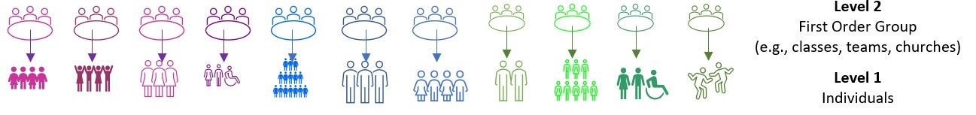
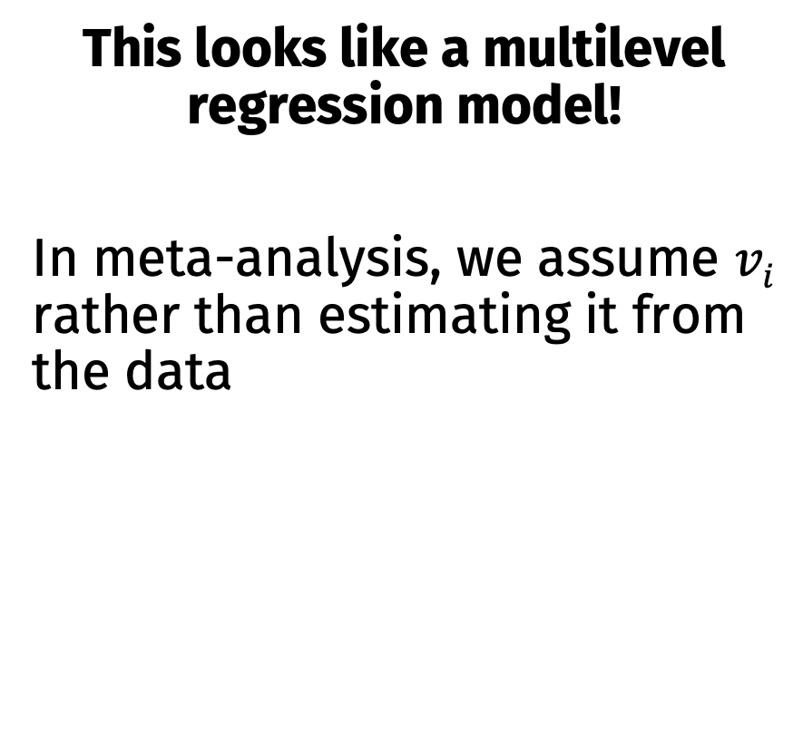
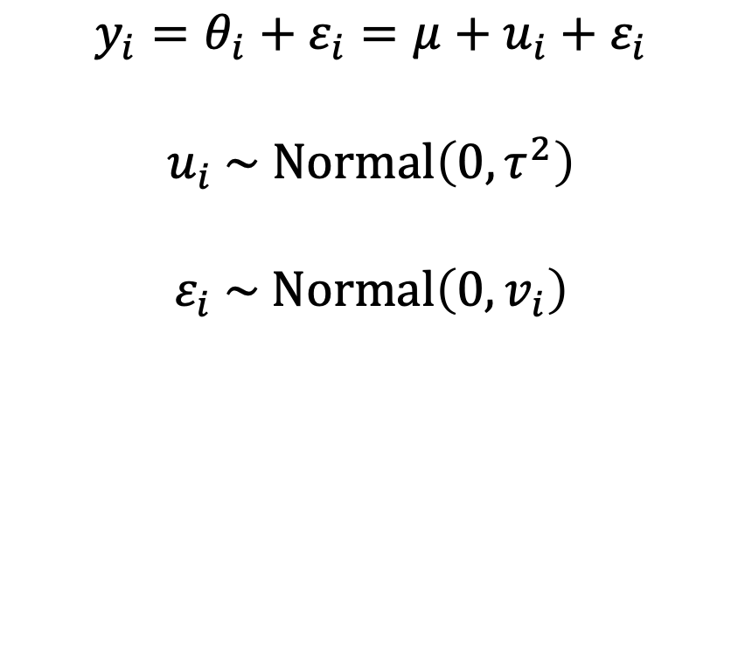
Random effects models as multilevel models
This looks like a multilevel regression model!
In meta-analysis, we assume $vi$ rather than estimating it from the data
$$y_{i}=θ_{i}+ε_{i}=μ+u_{i}+ε_{i}$$
$$u_{i} \sim Normal\left(0,τ^{2}\right)$$
$$ε_{i} \sim Normal\left(0,v_{i}\right)$$

Slide 35
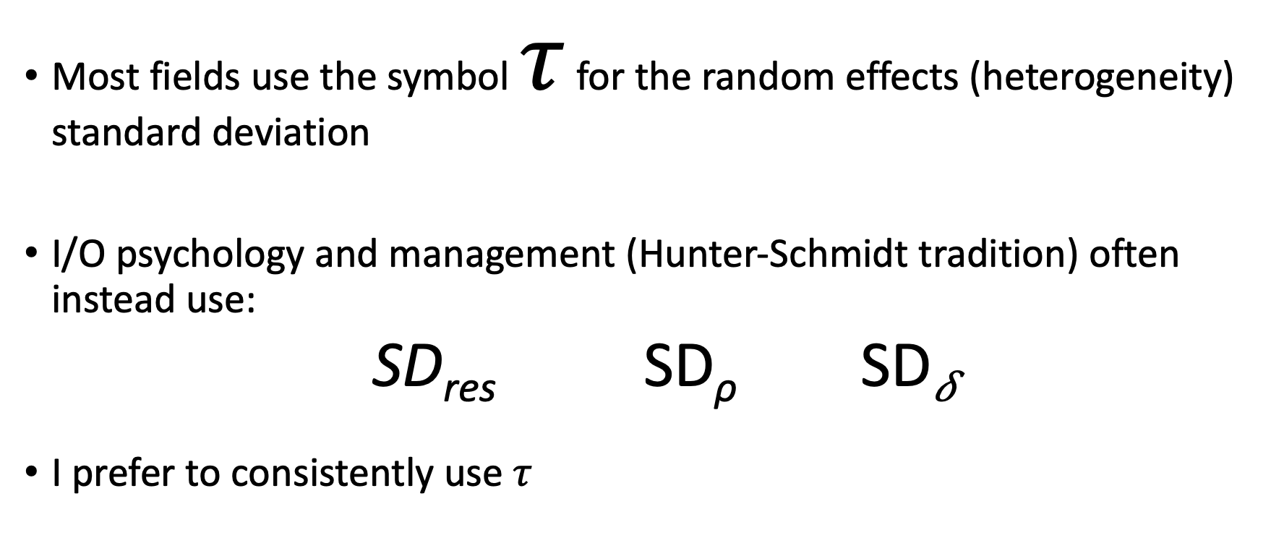
Terminology Note
Most fields use the symbol $τ$ for the random effects (heterogeneity) standard deviation
I/O psychology and management (Hunter-Schmidt tradition) often instead use:
SD_{res} SD_{ρ} SD_{𝛿}
I prefer to consistently use $τ$

Slide 36
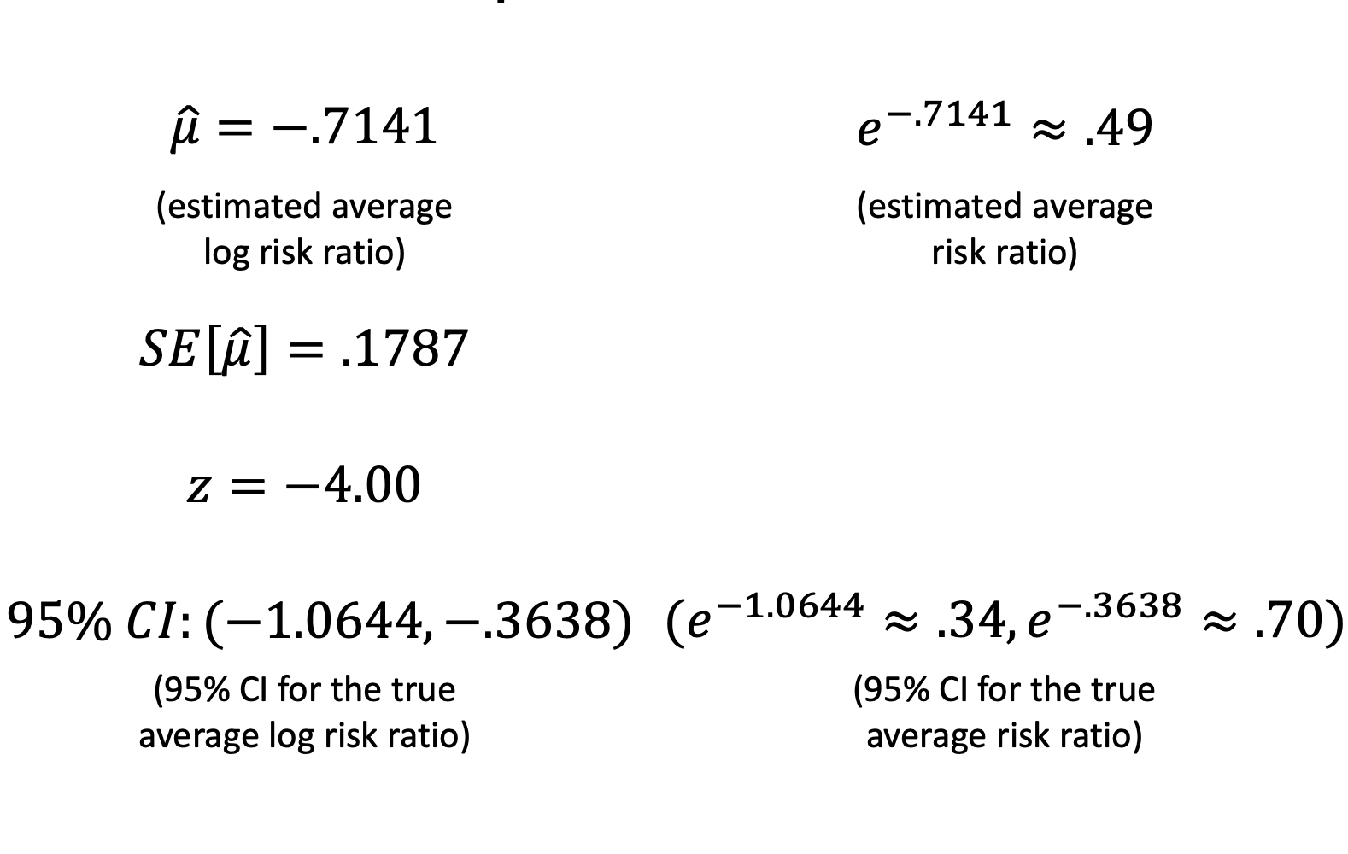
Example: BCG Vaccine

Slide 37
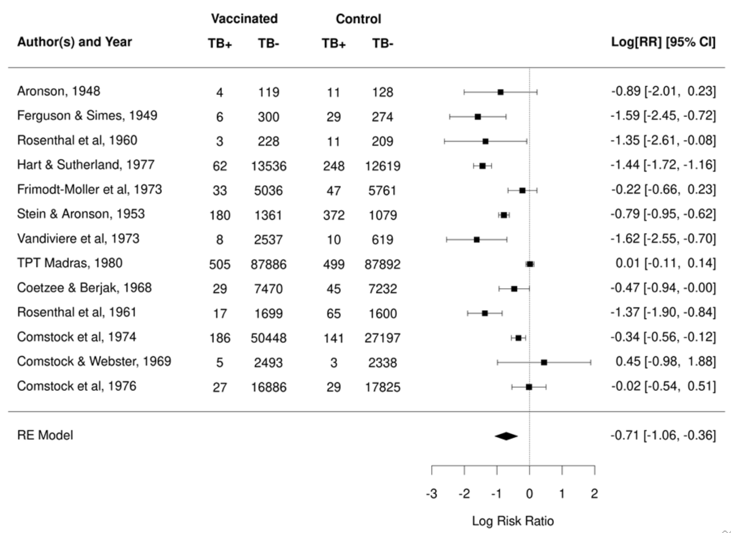

Slide 38
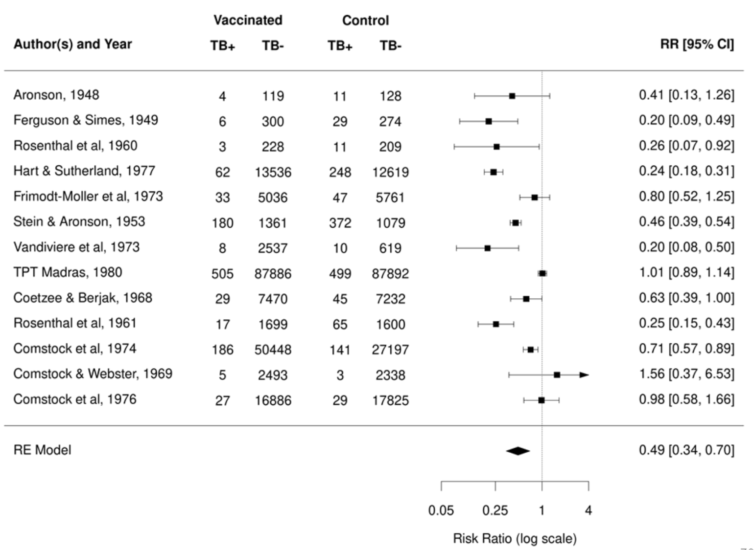

Slide 39
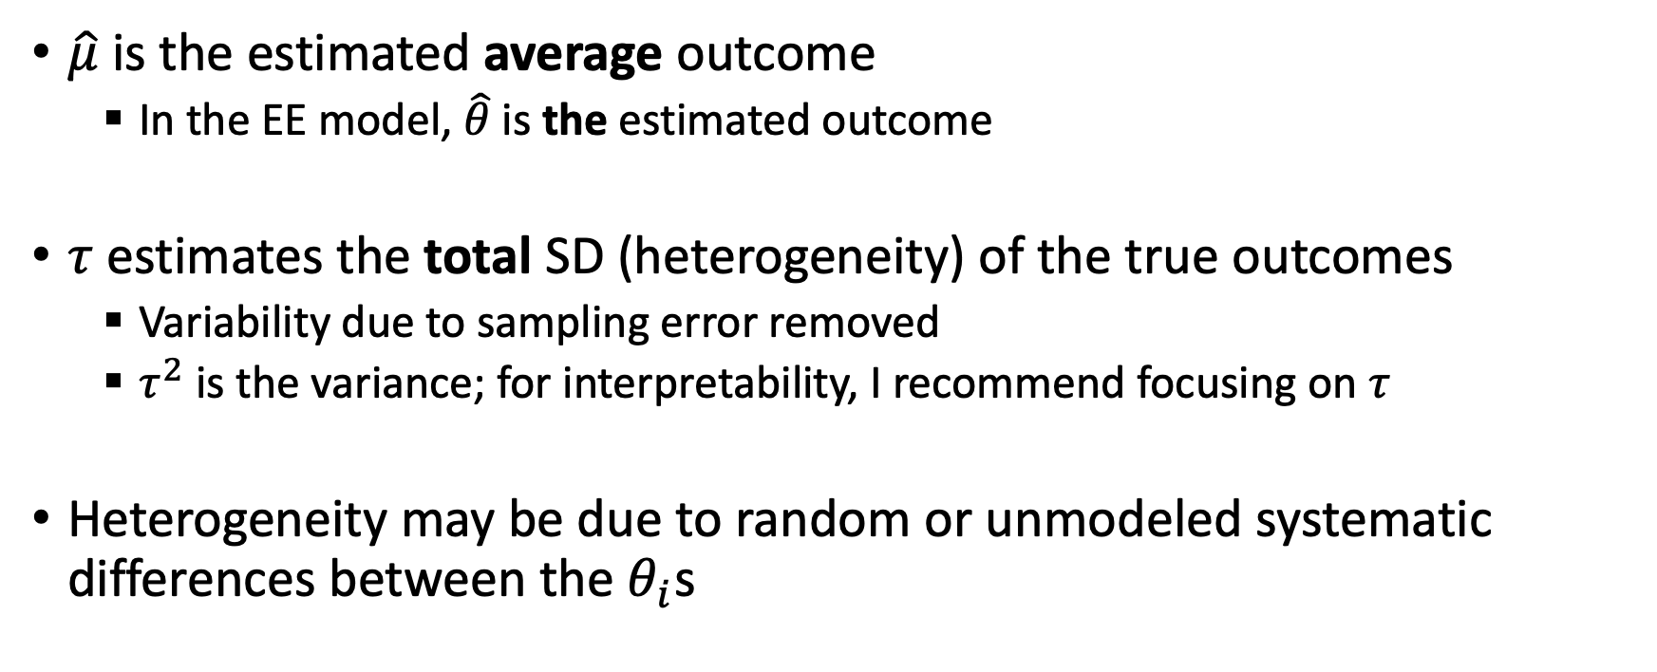
Interpreting RE model results
$\hat{μ}$ is the estimated average outcome
In the EE model, $\hat{θ}$ is the estimated outcome
$τ$ estimates the total SD (heterogeneity) of the true outcomes
Variability due to sampling error removed
$τ^{2}$ is the variance; for interpretability, I recommend focusing on $τ$
Heterogeneity may be due to random or unmodeled systematic differences between the $θ_{i}$s

Slide 40
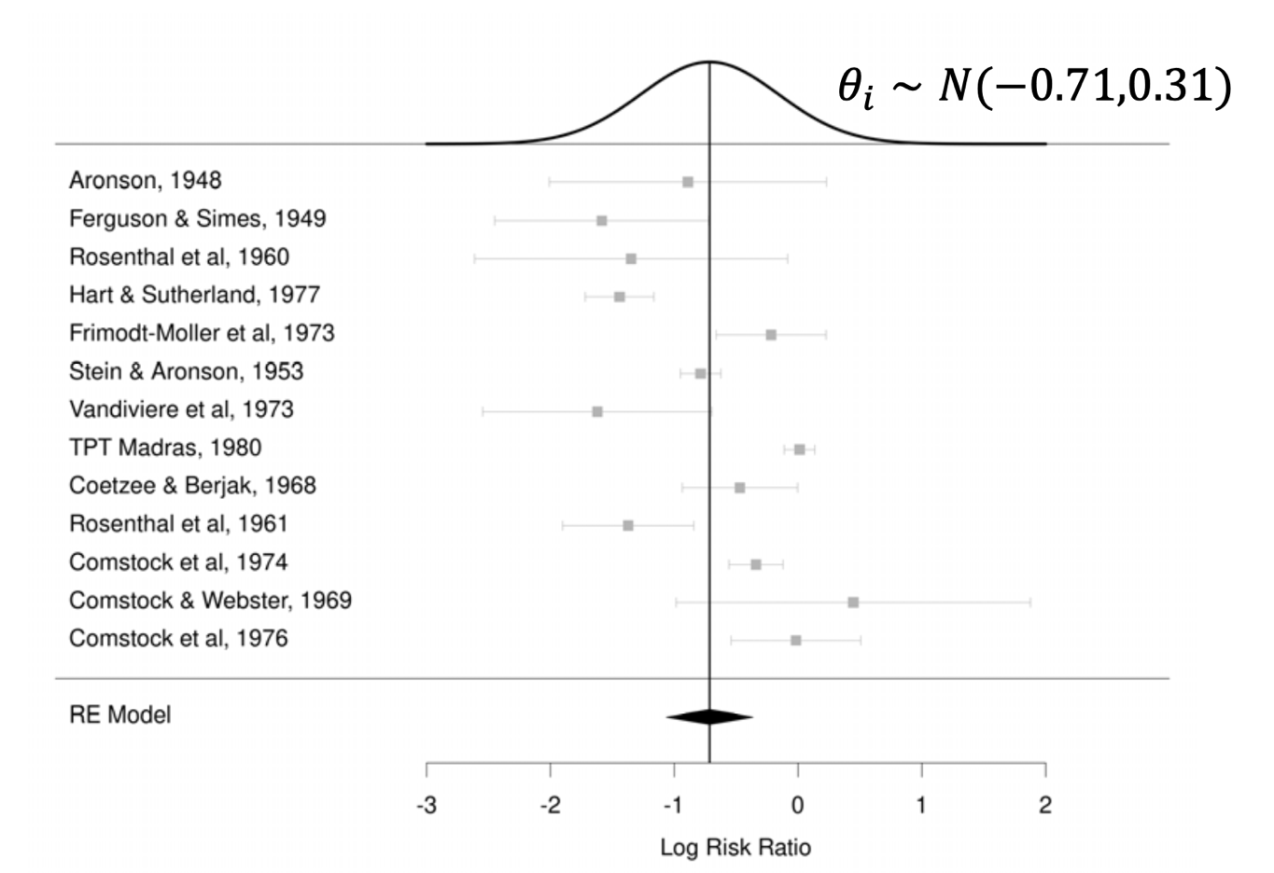

95% confidence interval for $μ$

Slide 41
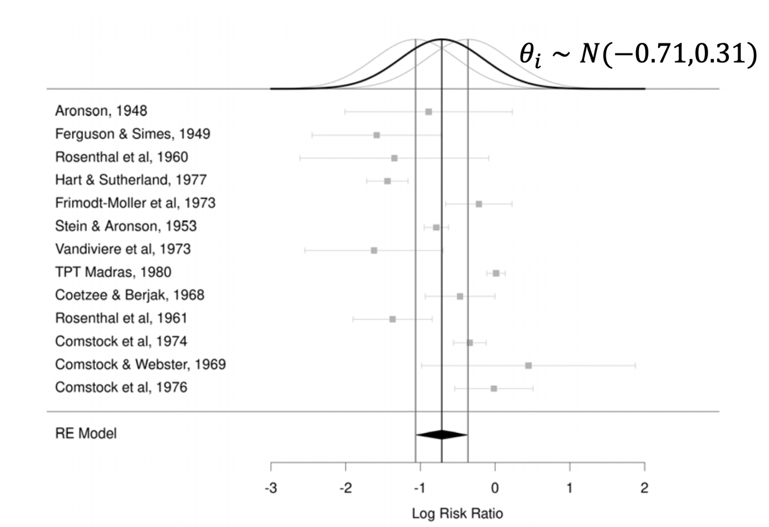

95% confidence interval for $μ$

Slide 42
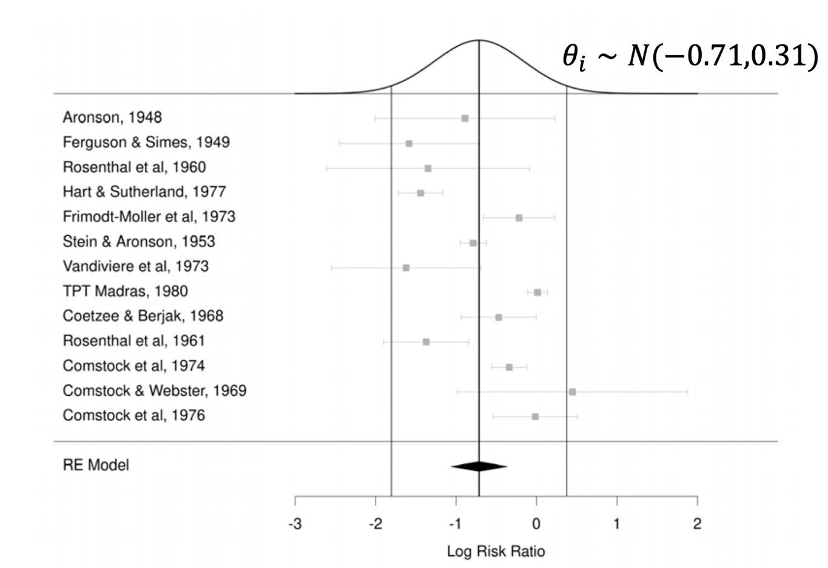

95% prediction interval for $θ_{i}$

Slide 43
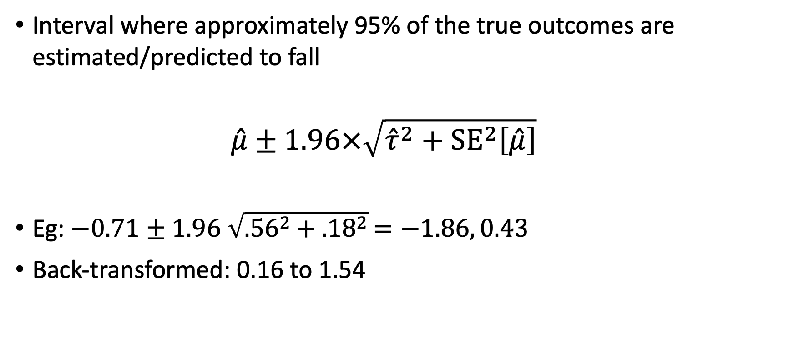

95% prediction interval for $θ_{i}$
Interval where approximately 95% of the true outcomes are estimated/predicted to fall
$$\hat{μ}±1.96×\sqrt{{\hat{τ}}^{2}+{SE}^{2}\left[\hat{μ}\right]}$$
Eg: $−0.71±1.96 \sqrt{{.56}^{2}+ {.18}^{2}}=−1.86, 0.43$
Back-transformed: 0.16 to 1.54

Slide 44
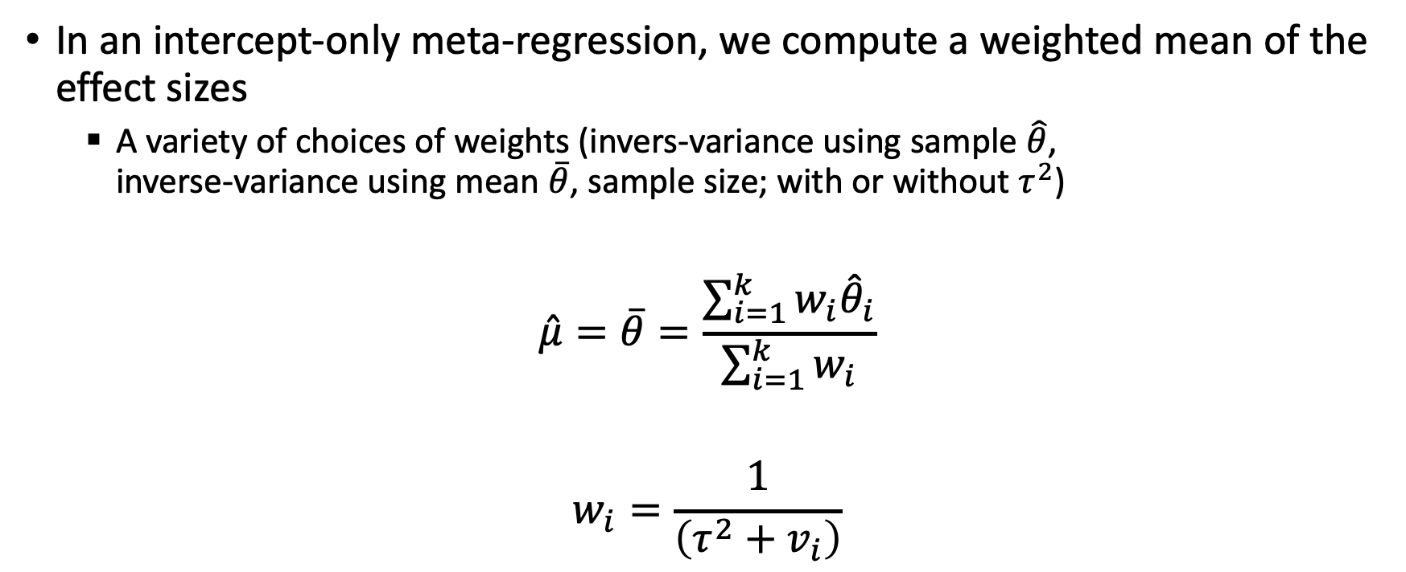
Estimating the mean effect size
In an intercept-only meta-regression, we compute a weighted mean of the effect sizes
A variety of choices of weights (invers-variance using sample $\hat{θ}$, inverse-variance using mean $\overline{θ}$, sample size; with or without $τ^{2}$)
$$\hat{μ}=\overline{θ}=\frac{\sum_{i=1}^{k}{w_{i}{\hat{θ}}_{i}}}{\sum_{i=1}^{k}{w_{i}}}$$
$$w_{i}=\frac{1}{\left({τ^{2}+v}_{i}\right)}$$

Slide 45
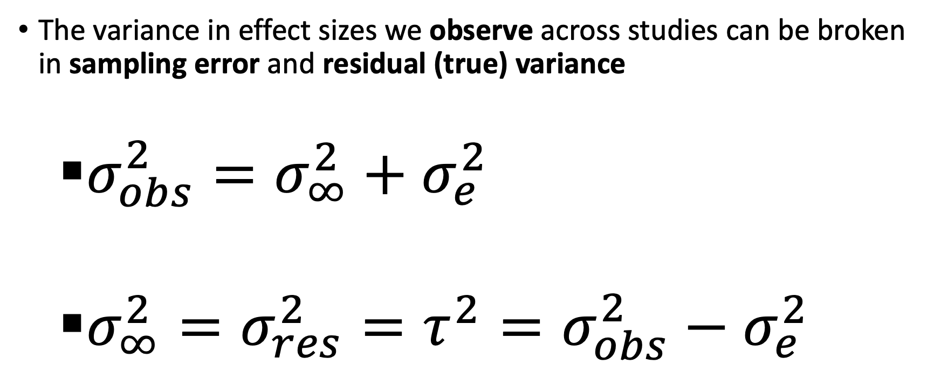
Estimating random effects variance
The variance in effect sizes we observe across studies can be broken in sampling error and residual (true) variance
$σ_{obs}^{2}=σ_{∞}^{2}+σ_{e}^{2}$
$σ_{∞}^{2}=σ_{res}^{2}=τ^{2}=σ_{obs}^{2}−σ_{e}^{2}$

Slide 46
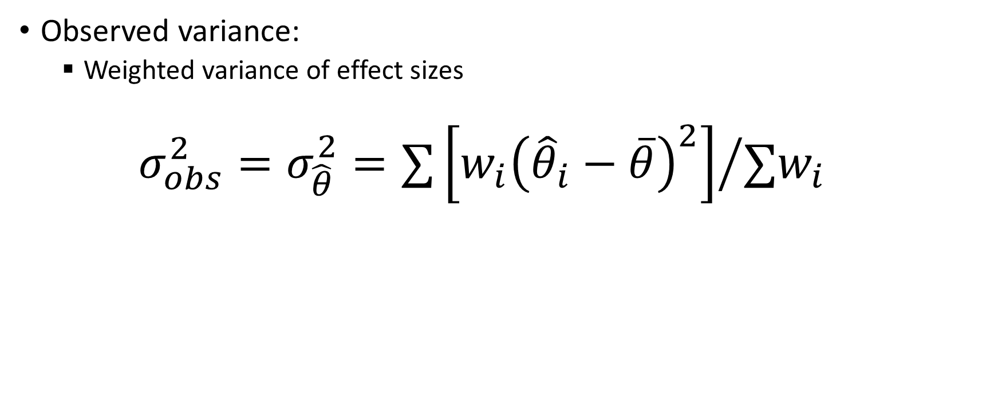
Observed Variance
Observed variance:
Weighted variance of effect sizes
$$σ_{obs}^{2}=σ_{\hat{θ}}^{2}={∑\left[w_{i}{\left({\hat{θ}}_{i}−\overline{θ}\right)}^{2}\right]}/{∑w_{i}}$$

Slide 47
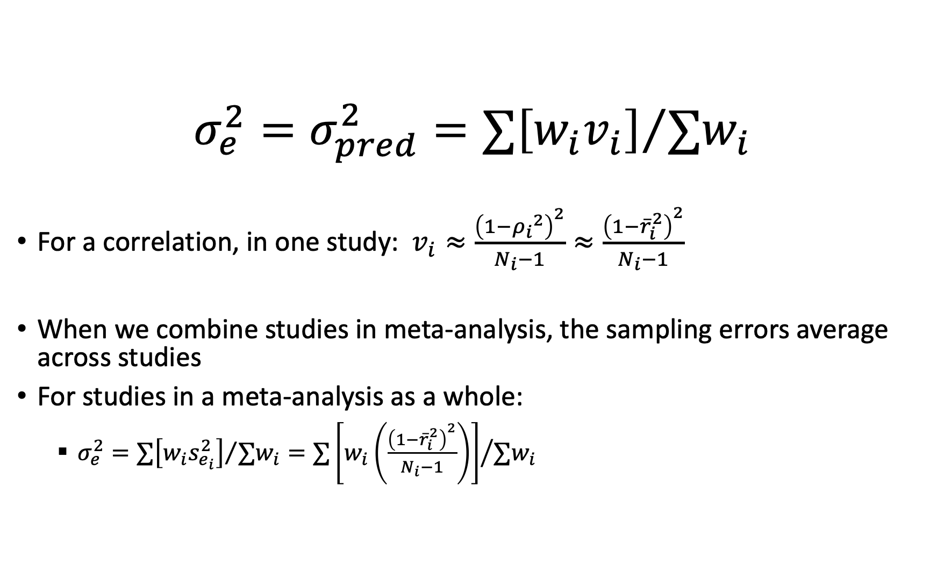
Expected/Predicted Variance (Sampling Error)
$$σ_{e}^{2}=σ_{pred}^{2}={∑\left[w_{i}v_{i}\right]}/{∑w_{i}}$$
For a correlation, in one study: $v_{i}≈\frac{{\left(1−{ρ_{i}}^{2}\right)}^{2}}{N_{i}−1}≈\frac{{\left(1−{\overline{r}}_{i}^{2}\right)}^{2}}{N_{i}−1}$
When we combine studies in meta-analysis, the sampling errors average across studies
For studies in a meta-analysis as a whole:
$σ_{e}^{2}={∑\left[w_{i}s_{e_{i}}^{2}\right]}/{∑w_{i}}={∑\left[w_{i}\left(\frac{{\left(1−{\overline{r}}_{i}^{2}\right)}^{2}}{N_{i}−1}\right)\right]}/{∑w_{i}}$

Slide 48
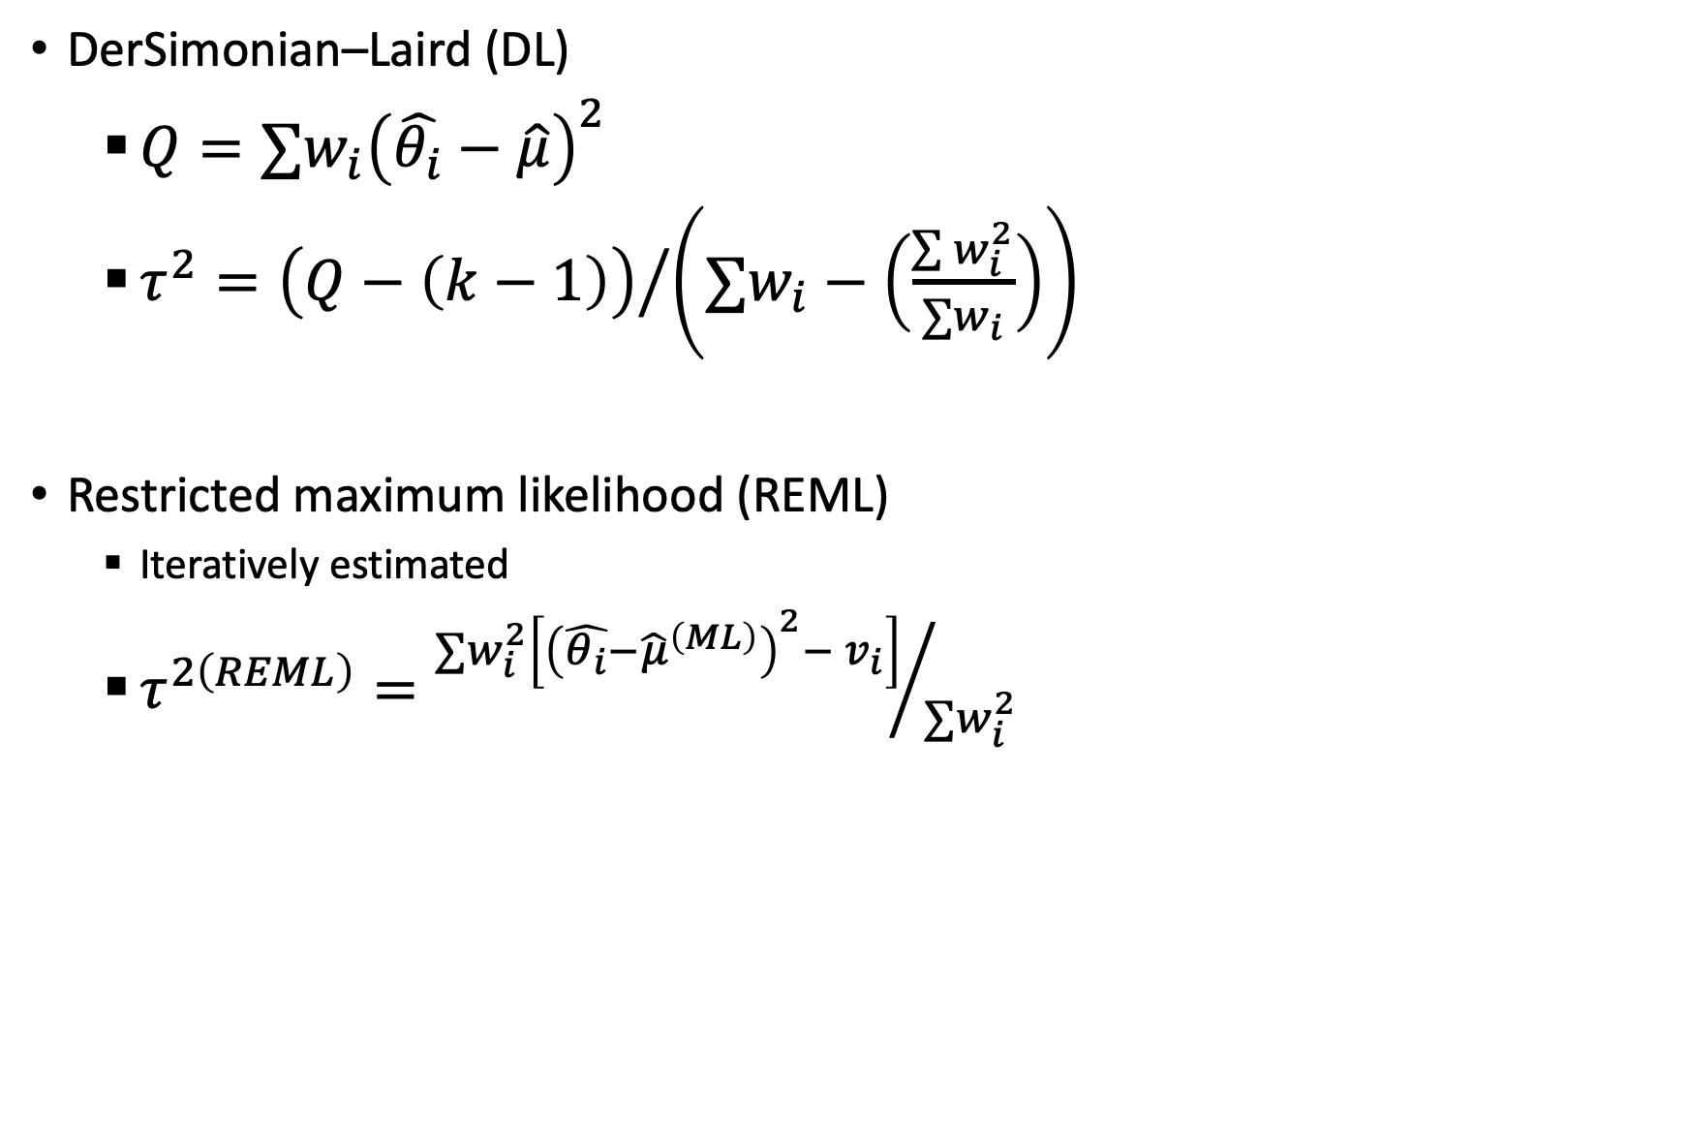
Estimators for τ²
DerSimonian–Laird (DL)
$Q=∑w_{i}{\left(\hat{θ_{i}}−\hat{μ}\right)}^{2}$
$τ^{2}={\left(Q−\left(k−1\right)\right)}/{\left(∑w_{i}−\left(\frac{\sum{w_{i}^{2}}}{∑w_{i}}\right)\right)}$
Restricted maximum likelihood (REML)
Iteratively estimated
$τ^{2\left(REML\right)}={∑w_{i}^{2}\left[{\left(\hat{θ_{i}}−{\hat{μ}}^{\left(ML\right)}\right)}^{2}− v_{i}\right]}/{∑w_{i}^{2}}$

Slide 49
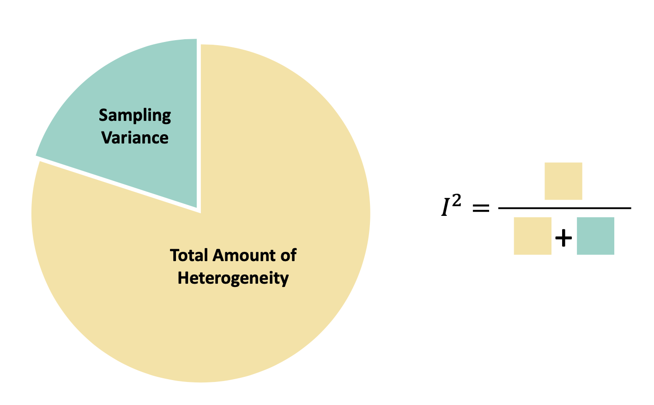
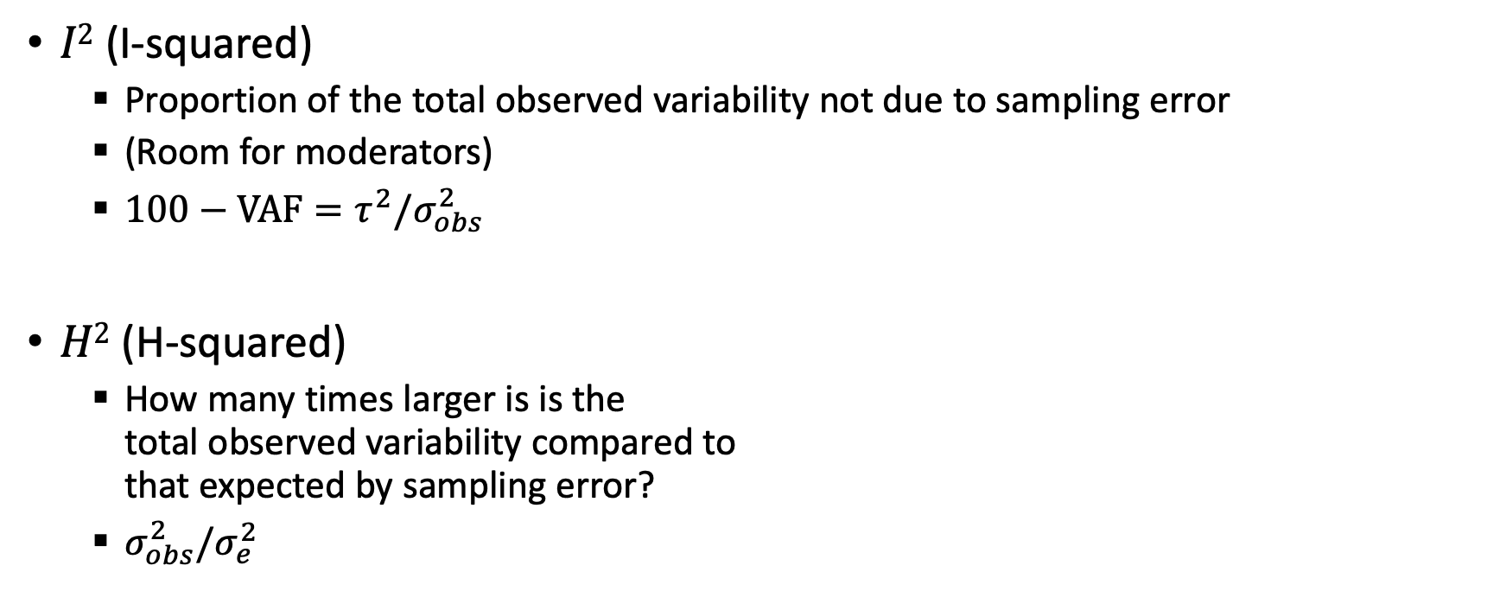
Related statistics
$I2$ (I-squared)
Proportion of the total observed variability not due to sampling error
(Room for moderators)
$100−VAF=τ^{2}/σ_{obs}^{2}$
$H2$ (H-squared)
How many times larger is is the total observed variability compared to that expected by sampling error?
$σ_{obs}^{2}/σ_{e}^{2}$

Slide 50
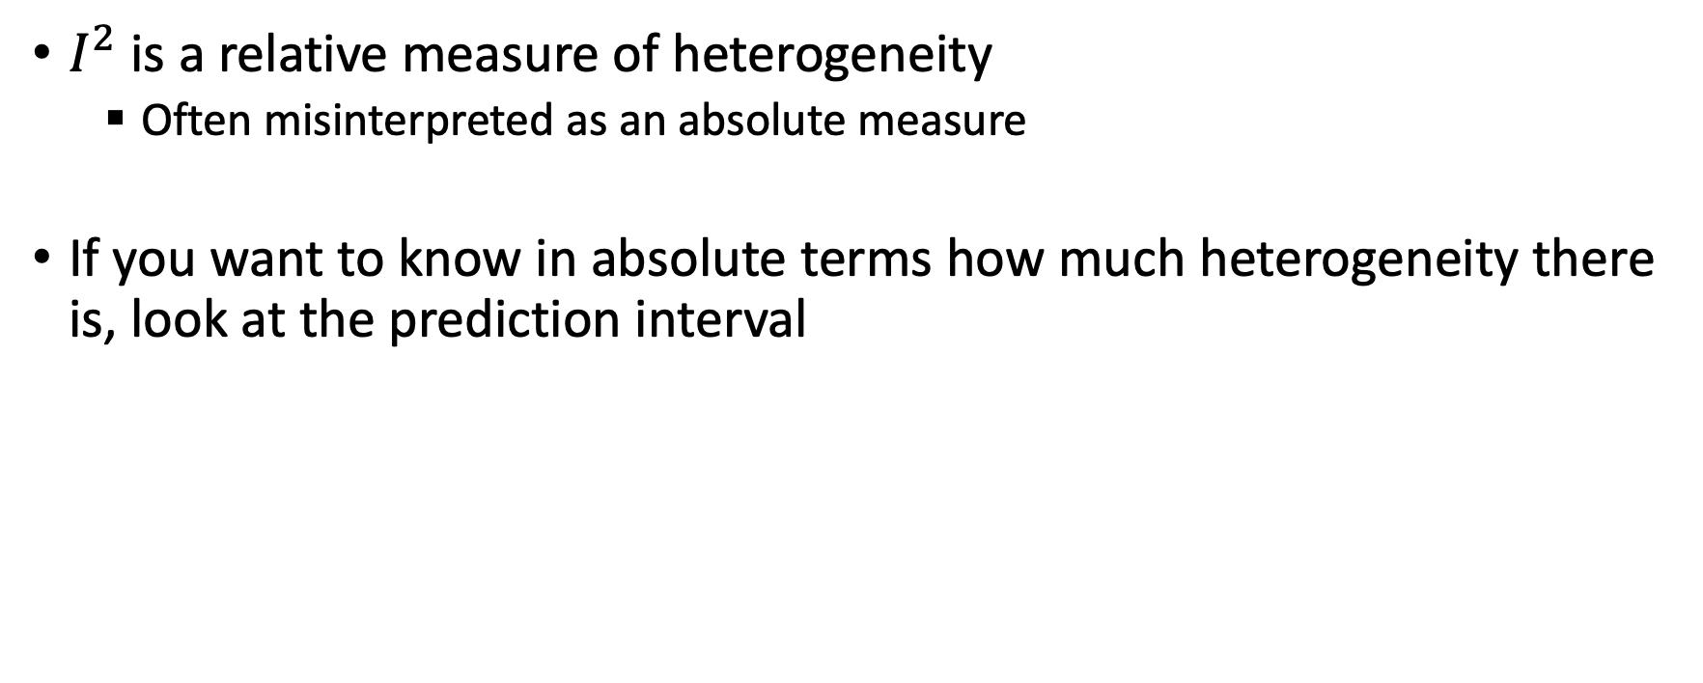
Relative vs. Absolute Heterogeneity
$I^{2}$ is a relative measure of heterogeneity
Often misinterpreted as an absolute measure
If you want to know in absolute terms how much heterogeneity there is, look at the prediction interval

Slide 51
Moderator Analysis
Meta-Regression
Subgroup Analysis

Slide 52
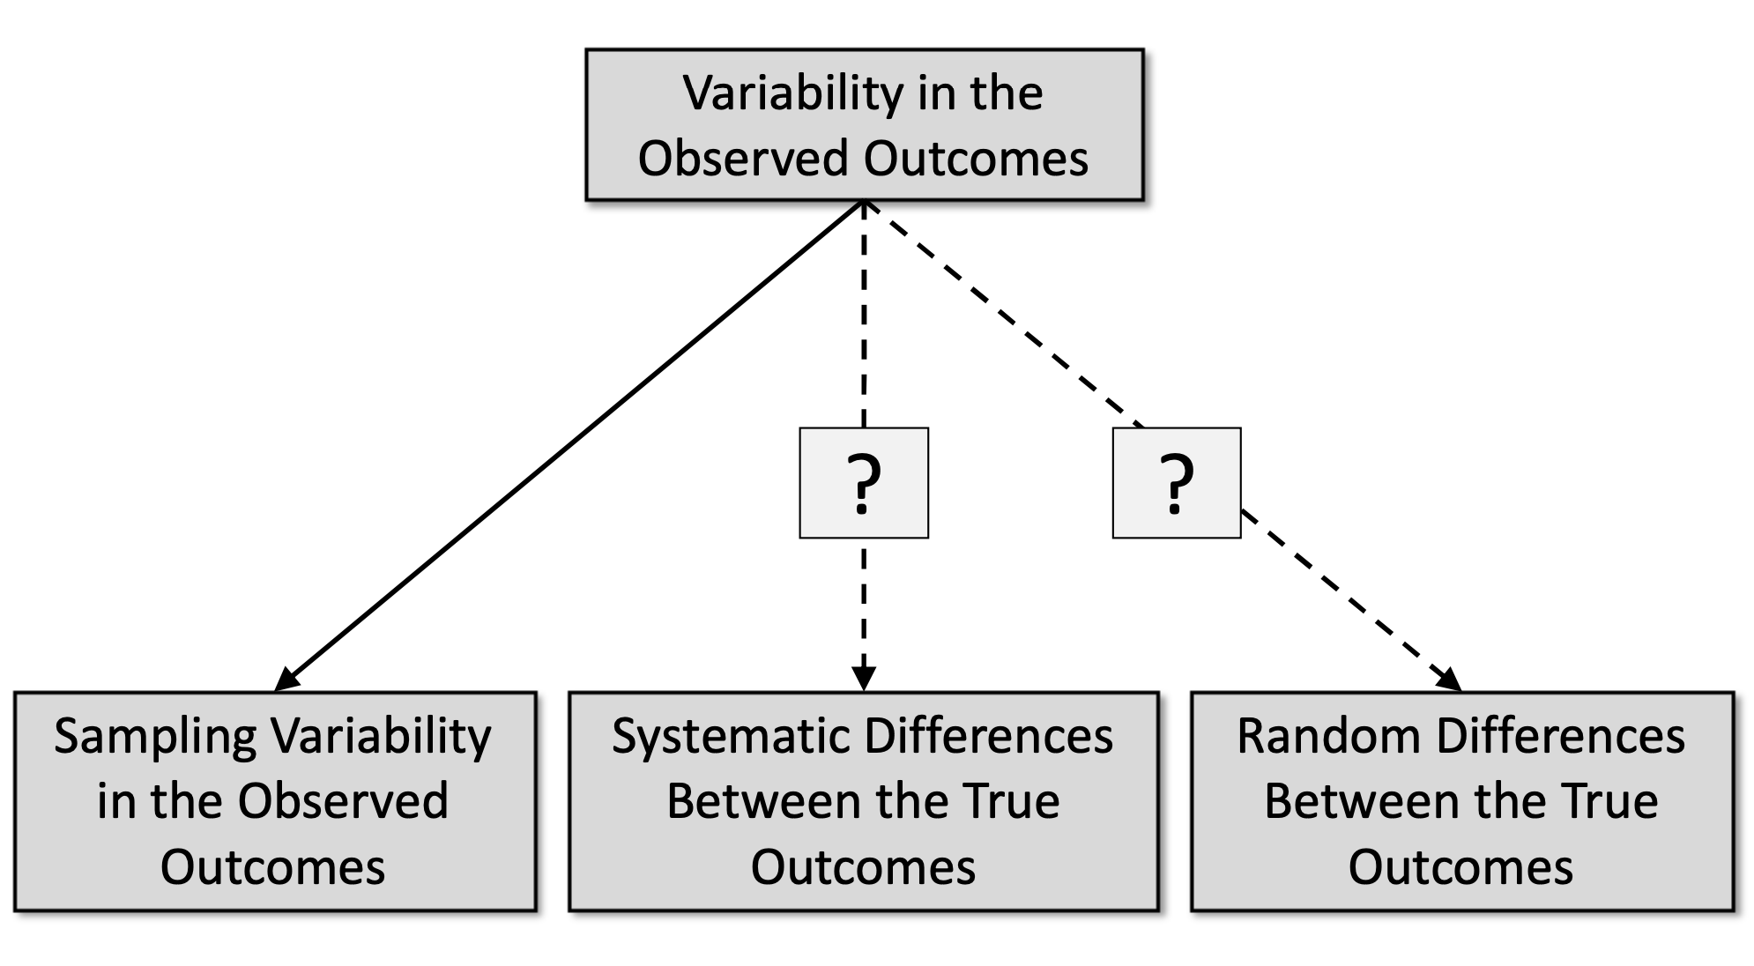
Sources of Variability in Outcomes

Slide 53
The relevant sample size for meta-regression is the number of studies/effect sizes!
Be skeptical of meta-analyses that…
Report many moderator analyses with few studies
Report continuous variable meta-regression with few studies
Report multivariable meta-regression with few studies

Slide 54
Publication Bias

Slide 55
Publication bias and questionable research practices
Statistically significant findings are:
more likely to be published
more likely to be published quicker
more likely to be cited in English journals
more likely to be published more than once
more likely to be cited by others
…
To get statistically significant results, researchers are likely to:
try out several analyses
selectively drop “outliers” or other cases
drop measures or conditions that “didn’t work”
round numbers selectively
…

Slide 56


Slide 57
Does your literature have publication bias?
tl;dr : Yes

Slide 58
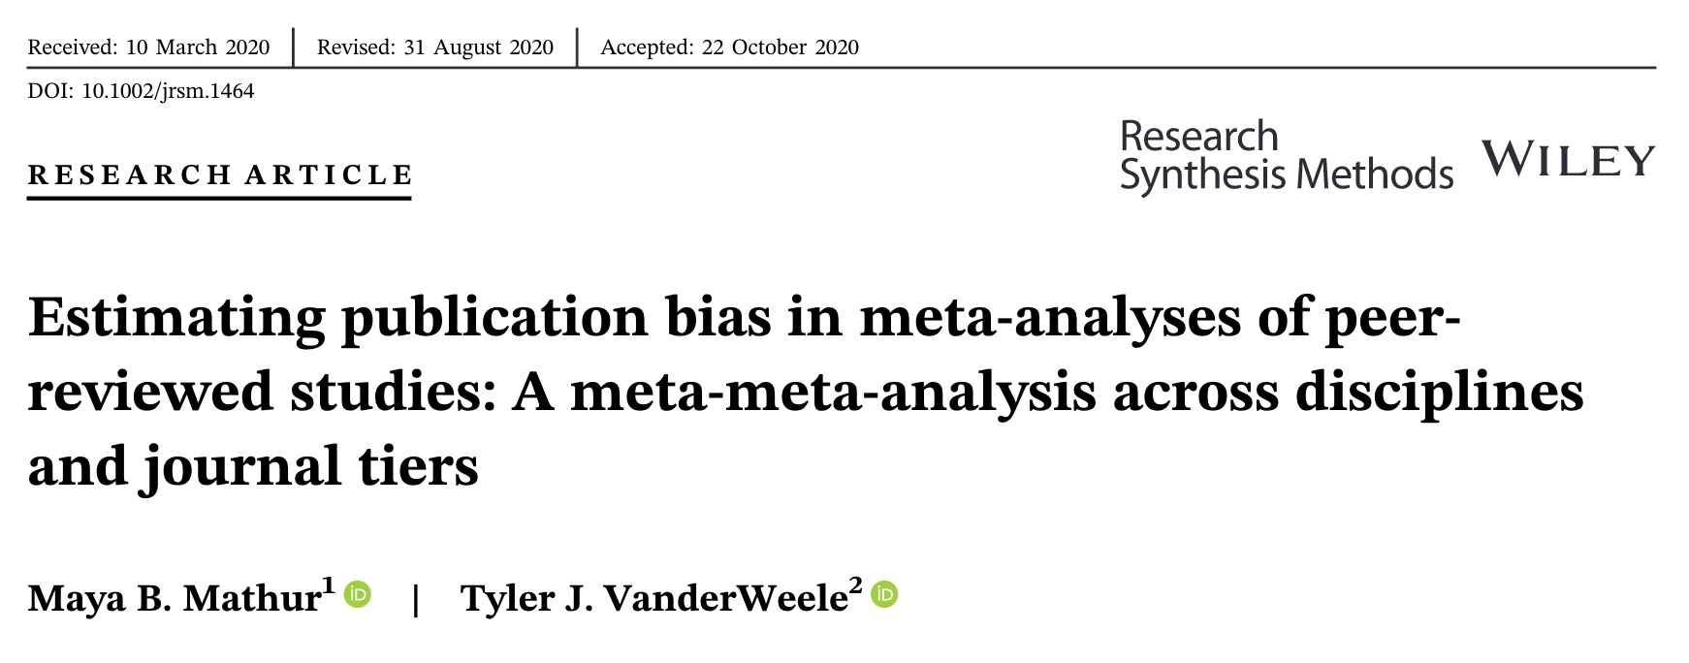
Does your literature have publication bias?
More nuanced: It depends. Probably.
Less likely:
Meta-analyses of registered studies
Meta-analyses of “non-headline” results
(Mathur & VanderWeele, 2021, https://doi.org/gmdbxw)

Slide 59
A meta-analysis should always discuss publication bias, whether it is relevant for the literature, and, if necessary, publication bias analyses
Analyses that should usually be reported:
Funnel plot, PET-PEESE (Egger’s test/Regression test),
Cumulative meta-analysis/WAAP
Analyses to be skeptical of:
Fail-safe N, Trim-and-Fill, p-curve, p-uniform

Slide 60
Dependent Effects
Multilevel, Multivariate, and Robust Meta-Analysis

Slide 61
Dependency
Most meta-analyses include studies that report multiple outcomes
Multiple outcomes for same group
e.g., infection, severe disease, death
e.g., Extraversion, Conscientiousness, Agreeableness
Multiple measures of the same concept
Shared samples
e.g., multiple time points or publications
e.g., common control group
Overlapping influences
e.g., Overlapping geographic locations
e.g., Same lab or research group

Slide 62
Meta-analyses should use modern methods to handle dependency
Be skeptical of meta-analyses that:
Do not discuss effect dependency
Use ad hoc methods like averaging effect sizes or randomly selecting one
Instead look for:
Robust, Multi-level, Multivariate, or Network meta-analysis

Slide 63
Reporting Guidelines

Slide 64
Guidelines
APA Style JARS Table 9: Quantitative meta-analysis article reporting standards. American Psychological Association. https://apastyle.apa.org/jars/quant-table-9.pdf
The PRISMA 2020 statement: An updated guideline for reporting systematic reviews. BMJ, n71. https://doi.org/10/gjkq9b
PRISMA 2020 explanation and elaboration: Updated guidance and exemplars for reporting systematic reviews. BMJ, n160. https://doi.org/10/gjkrwz
PRISMA Group. (n.d.). PRISMA 2020 checklist. https://doi.org/10.1136/bmj.n71
PRISMA-S: An extension to the PRISMA Statement for Reporting Literature Searches in Systematic Reviews. Systematic Reviews, 10(1), 39. https://doi.org/10/gh2z2k

Slide 65
Conducting and Reporting a Systematic Review
Literature searches in systematic reviews and meta-analyses: A review, evaluation, and recommendations. Journal of Vocational Behavior, 118, 103377. https://doi.org/10/ggh2bx
How to do a systematic review: A best practice guide for conducting and reporting narrative reviews, meta-analyses, and meta-syntheses. Annual Review of Psychology, 70(1), 747–770. https://doi.org/10/gftjxg

Slide 66
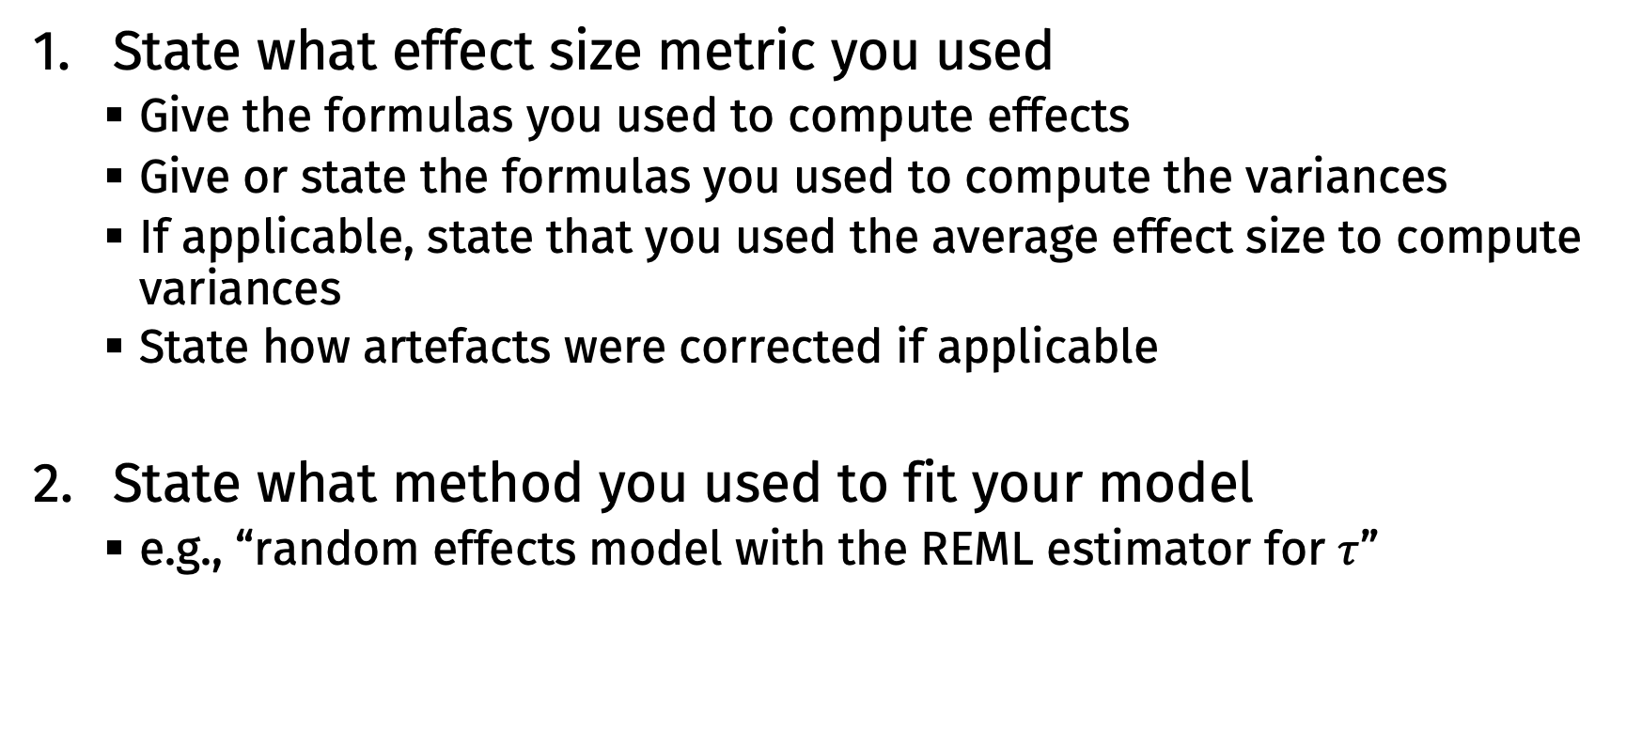
Reporting your model
State what effect size metric you used
Give the formulas you used to compute effects
Give or state the formulas you used to compute the variances
If applicable, state that you used the average effect size to compute variances
State how artefacts were corrected if applicable
State what method you used to fit your model
e.g., “random effects model with the REML estimator for $τ$”

Slide 67
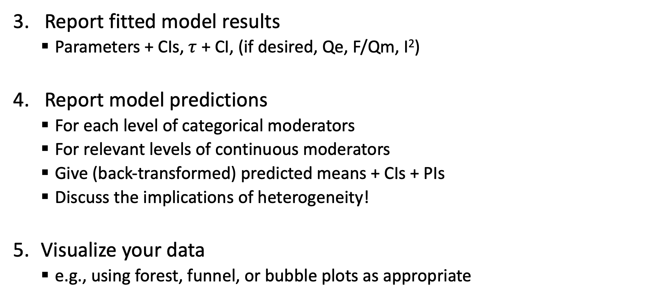
Reporting your model
Report fitted model results
Parameters + CIs, $τ$ + CI, (if desired, Qe, F/Qm, I²)
Report model predictions
For each level of categorical moderators
For relevant levels of continuous moderators
Give (back-transformed) predicted means + CIs + PIs
Discuss the implications of heterogeneity!
Visualize your data
e.g., using forest, funnel, or bubble plots as appropriate

Slide 68
Reporting your model
Discuss publication bias
Is it a concern?
Report funnel plots, regression tests, cumulative meta-analysis/WAAP
Consider other publication bias models as well
Discuss limitations of generalizability
Study populations, settings, etc.
Overall quality / threats to validity of the included studies
Share your data and analysis script in a public repository
e.g., https://osf.io

Slide 69
Learning More

Slide 70
Resources
Full meta-analysis workshop
https://github.com/bwiernik/meta-workshop
Includes slides, R code demonstrations, exercises, and solutions
I teach this workshop several times a year, email bmwiernik@outlook.com for more information
Additional resources:
Doing meta-analysis in R
Guide to effect sizes and confidence intervals
metafor website
psychmeta website

